Slide 1
60th Annual Dahlia Show
September 5– 6, 2026
Marysville, Ohio

Slide 2
The Set-Up

Slide 9
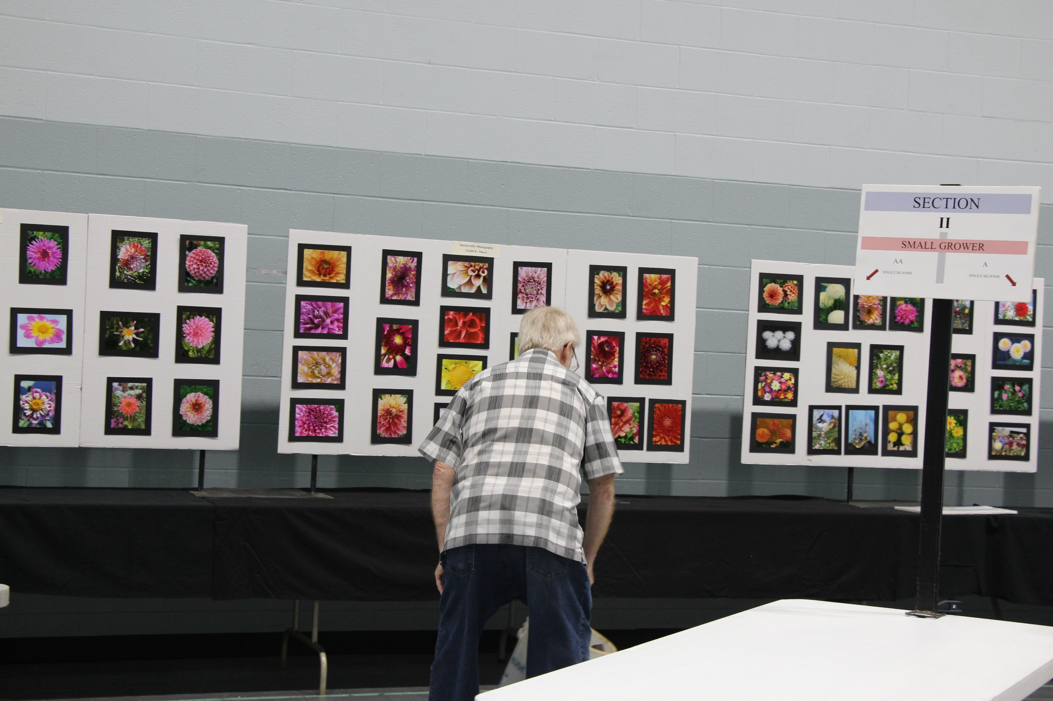

Slide 10
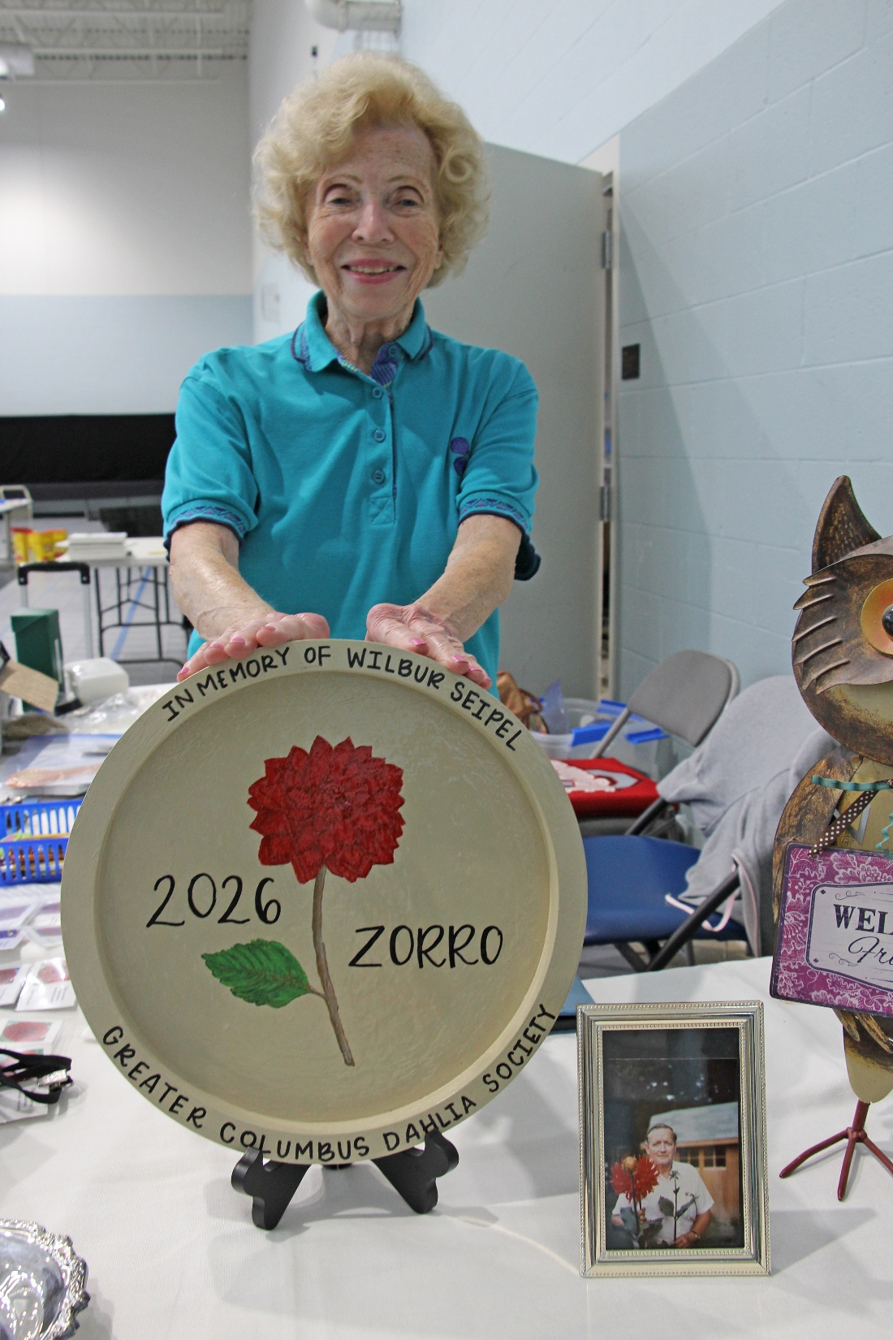

Slide 11
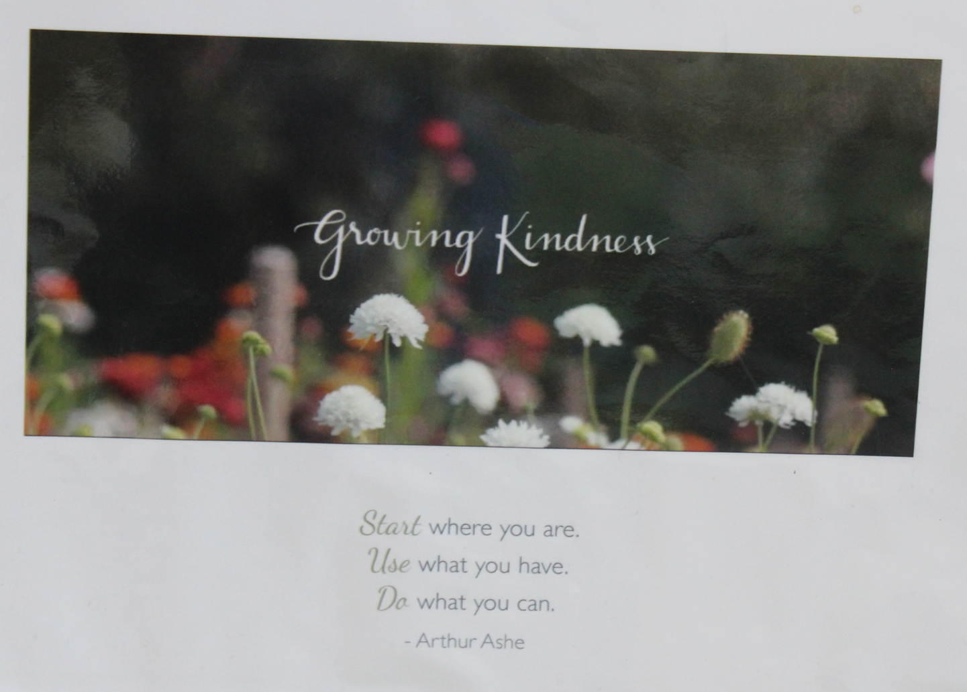

Slide 12
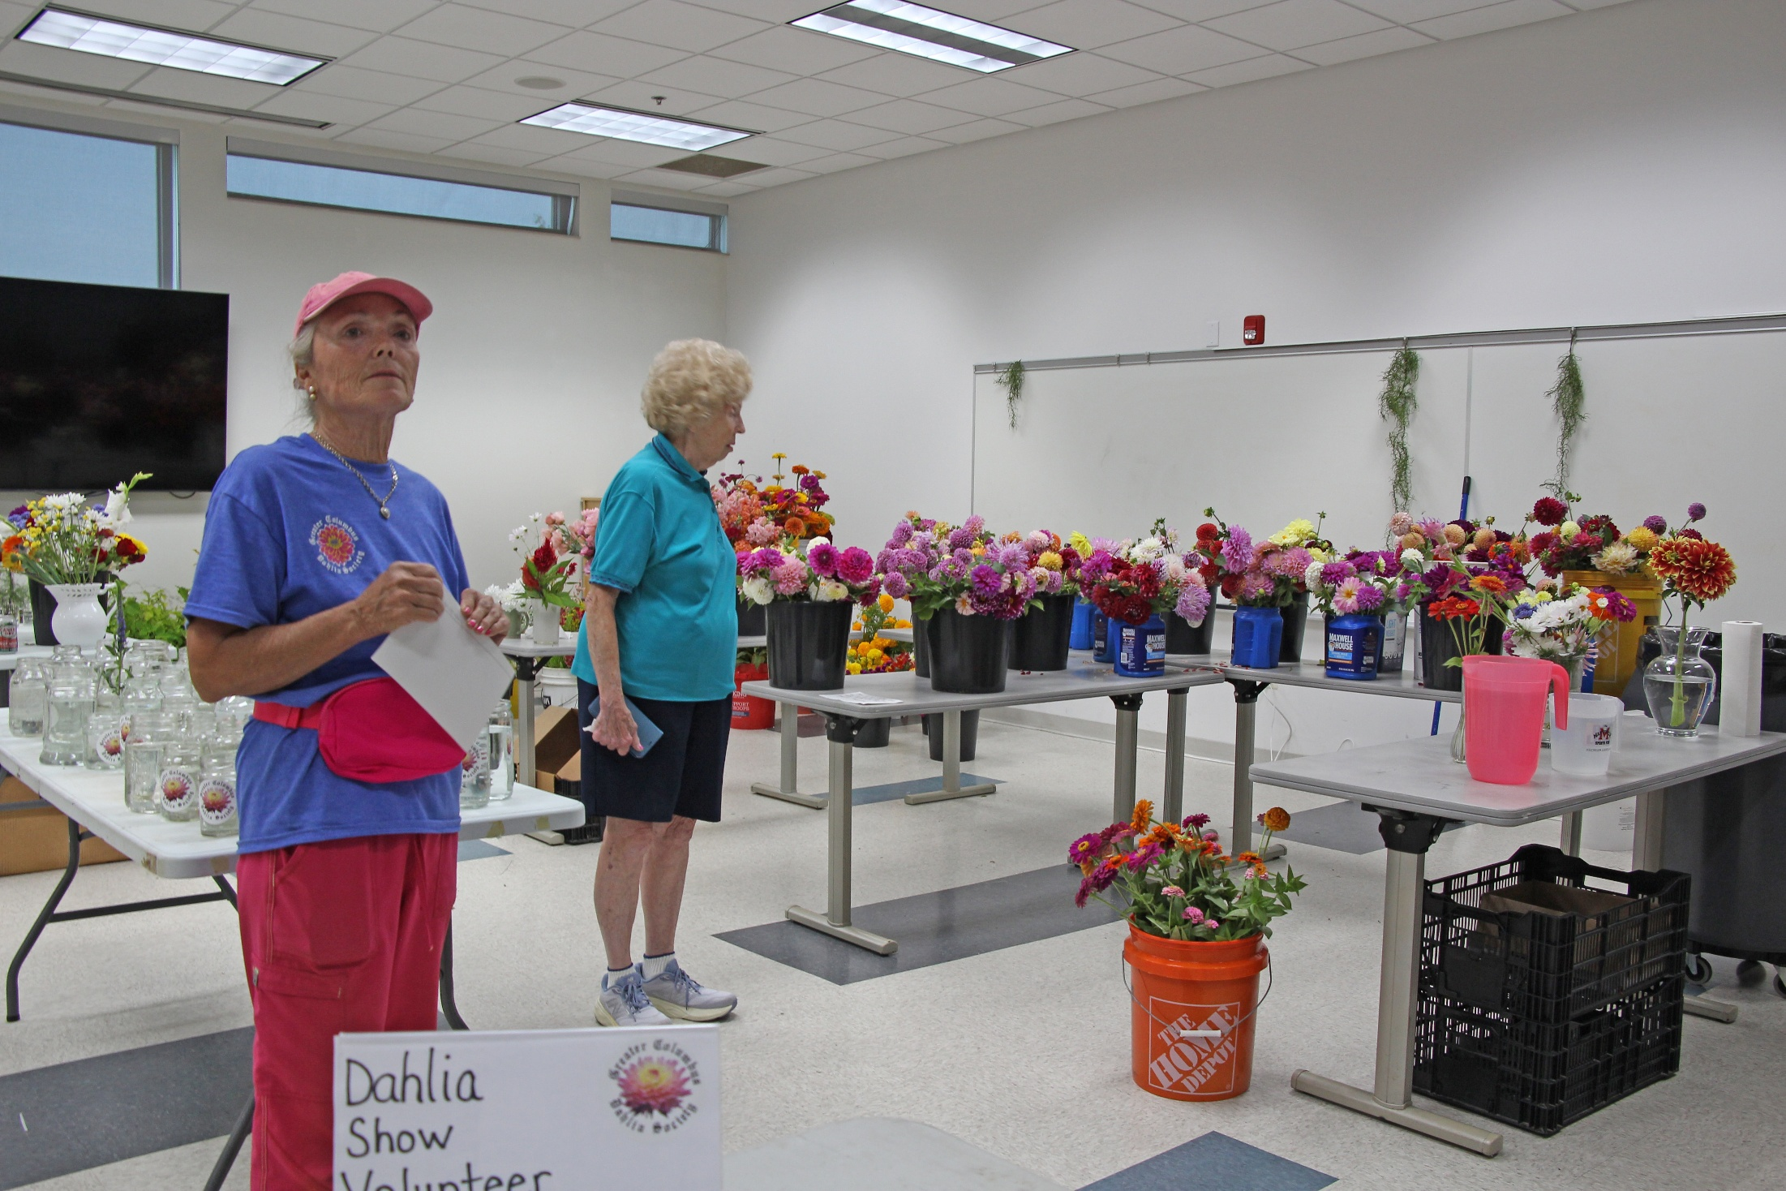

Slide 13
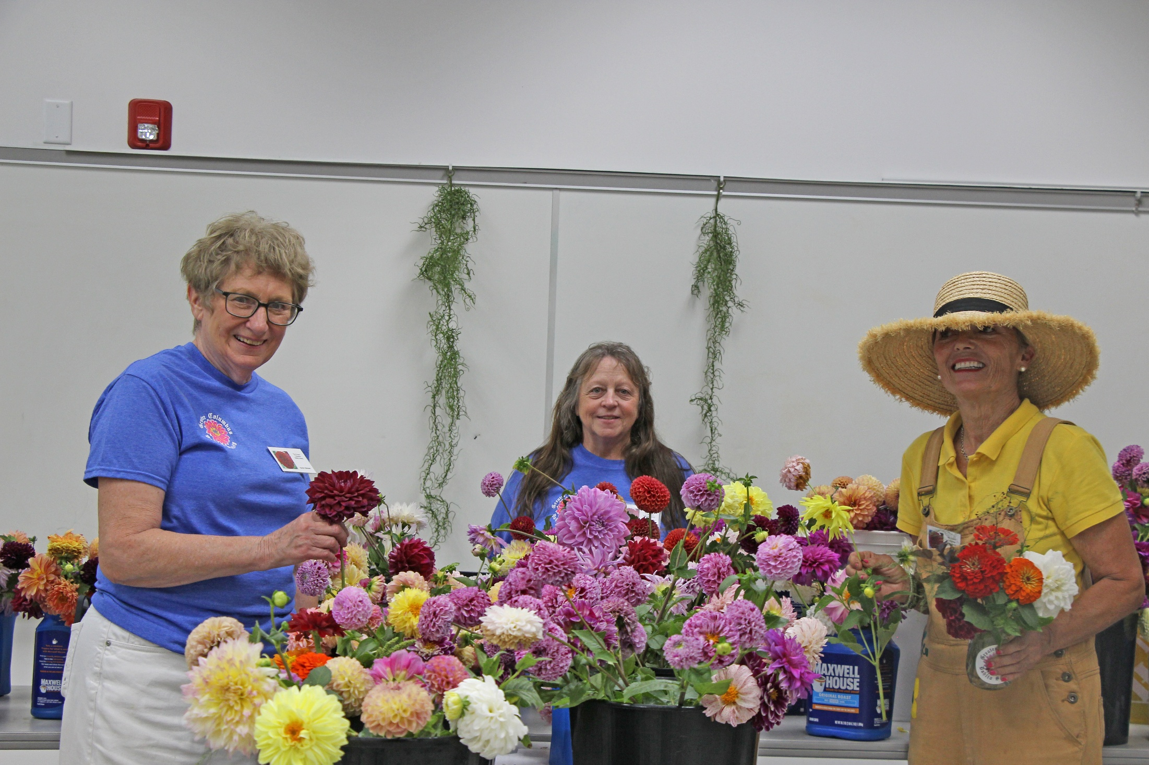

Slide 14
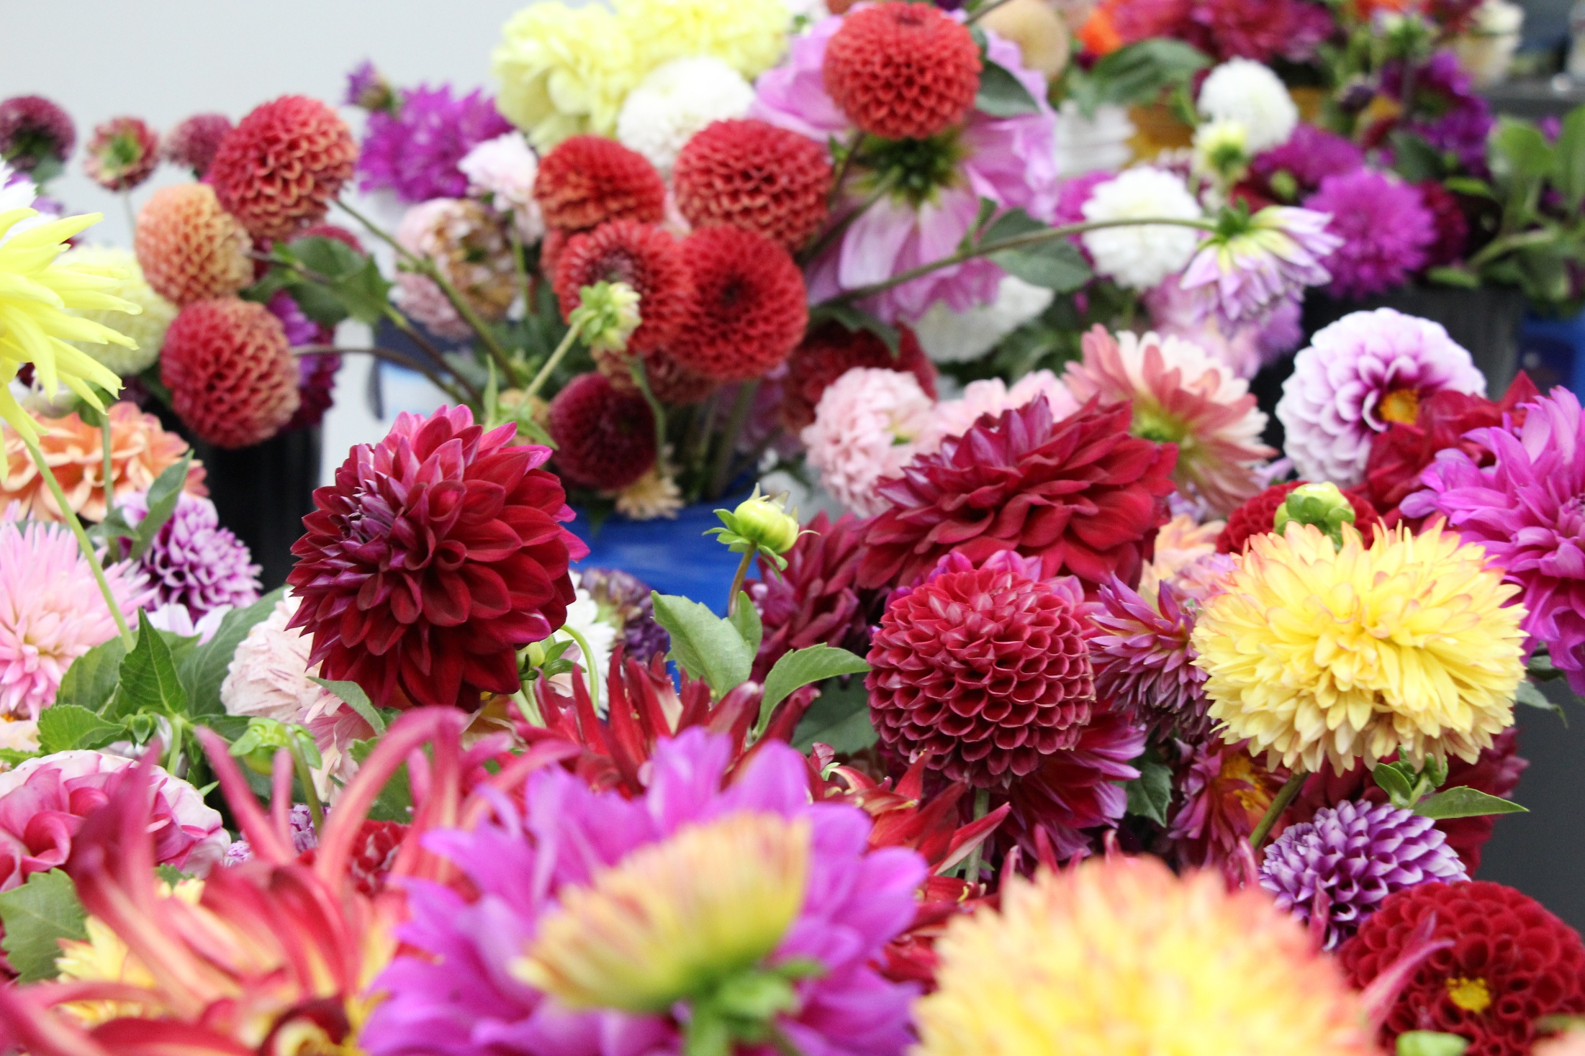

Slide 15
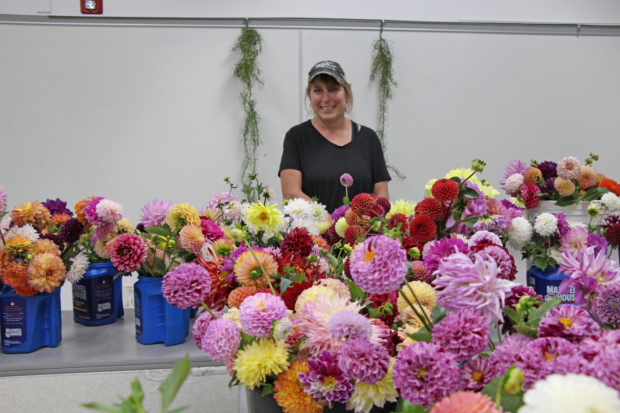

Slide 16
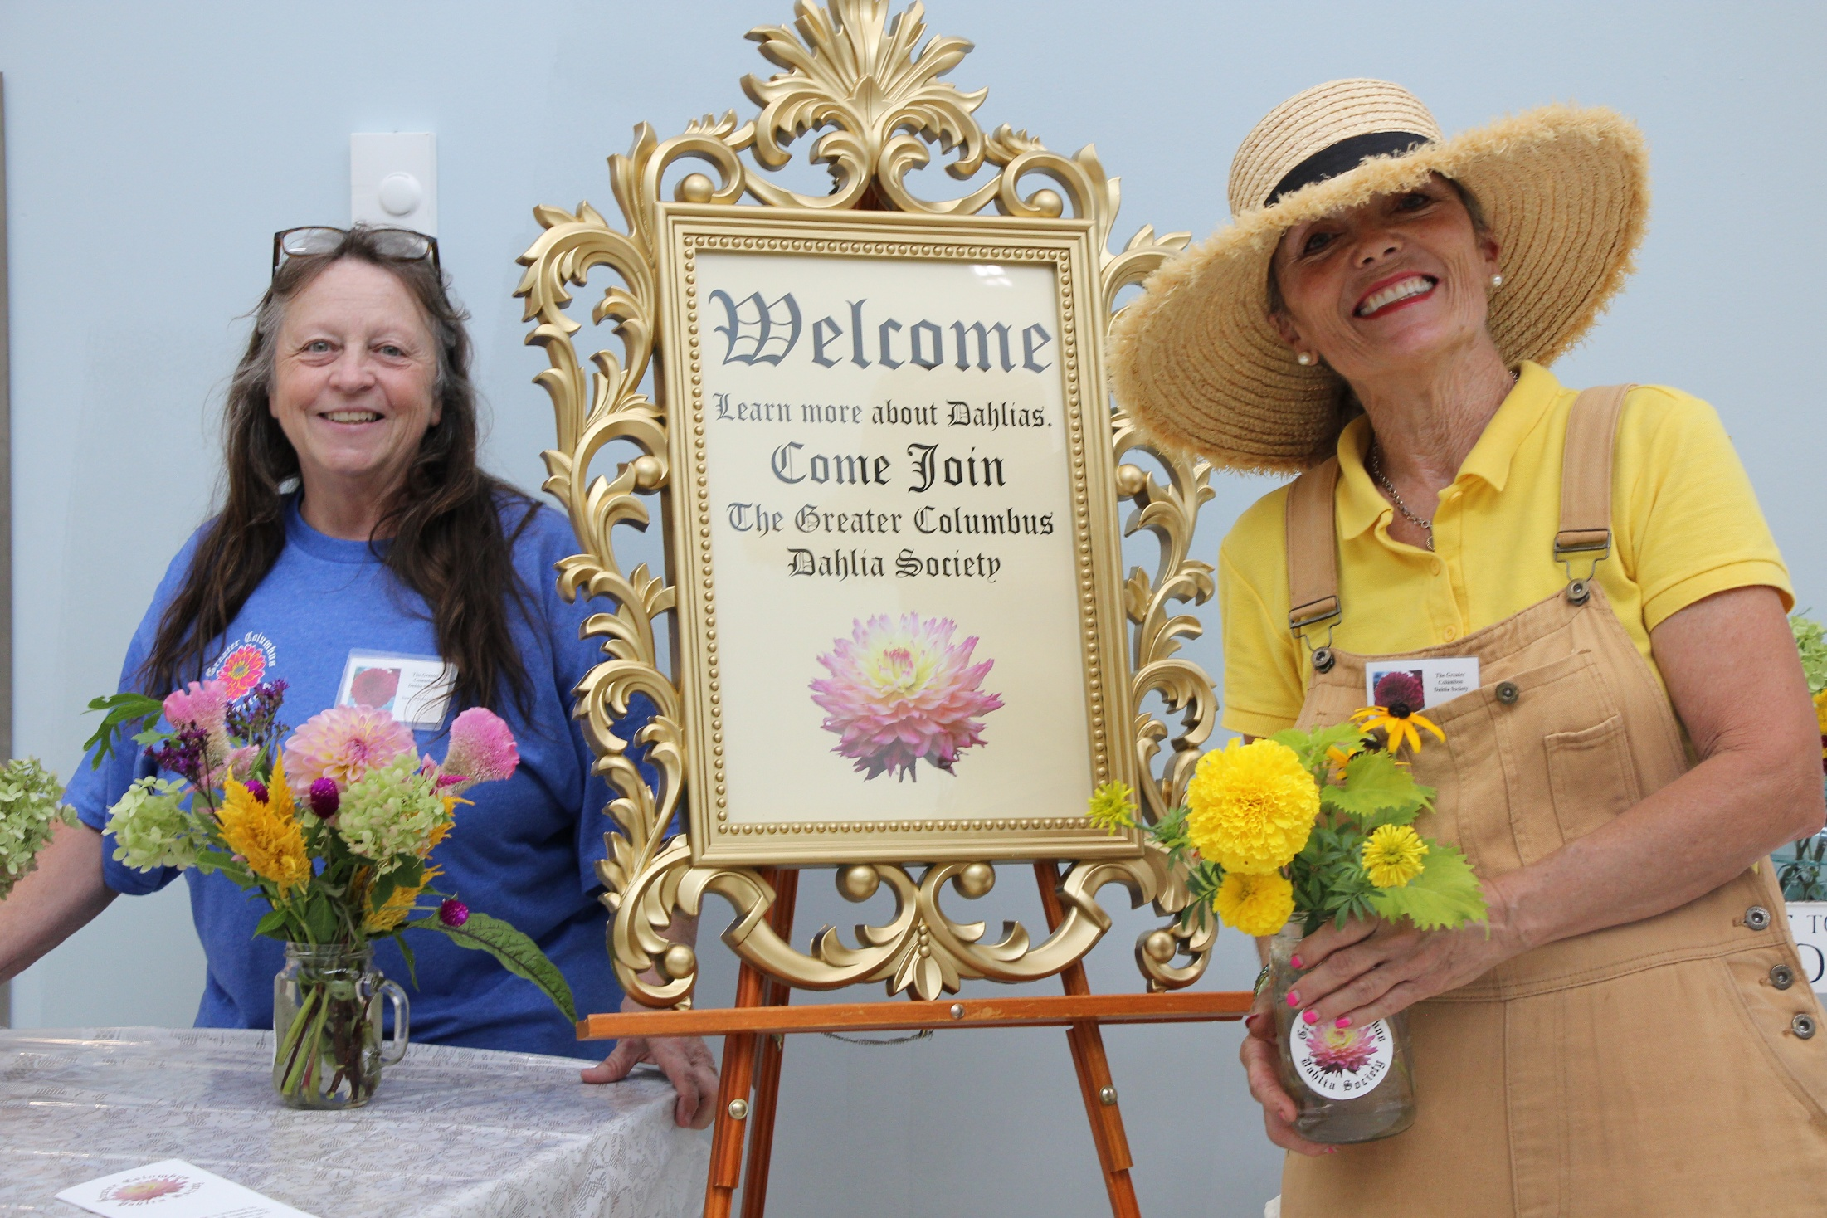

Slide 17
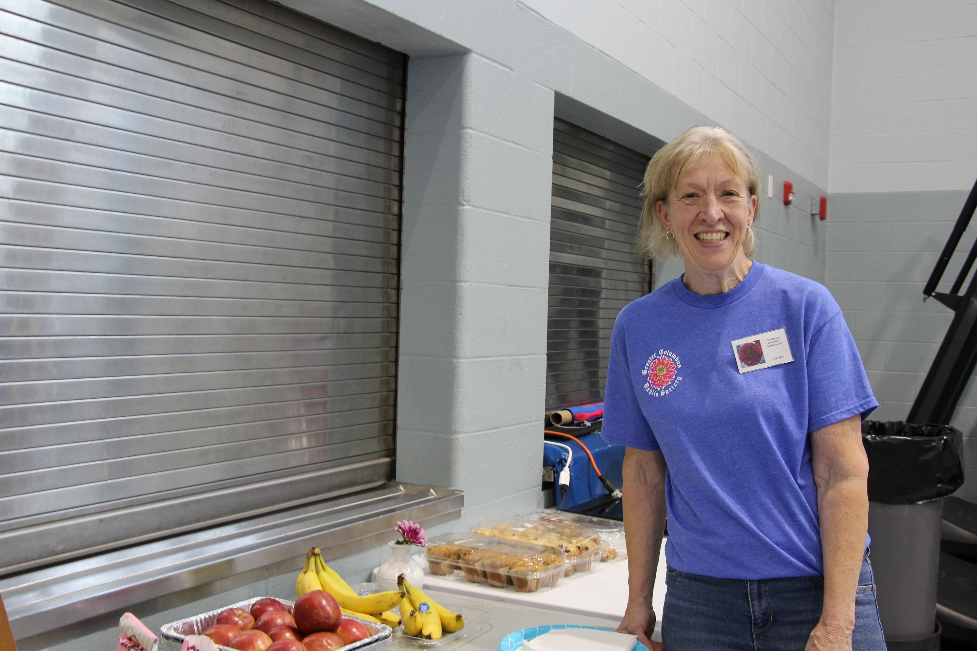

Slide 18
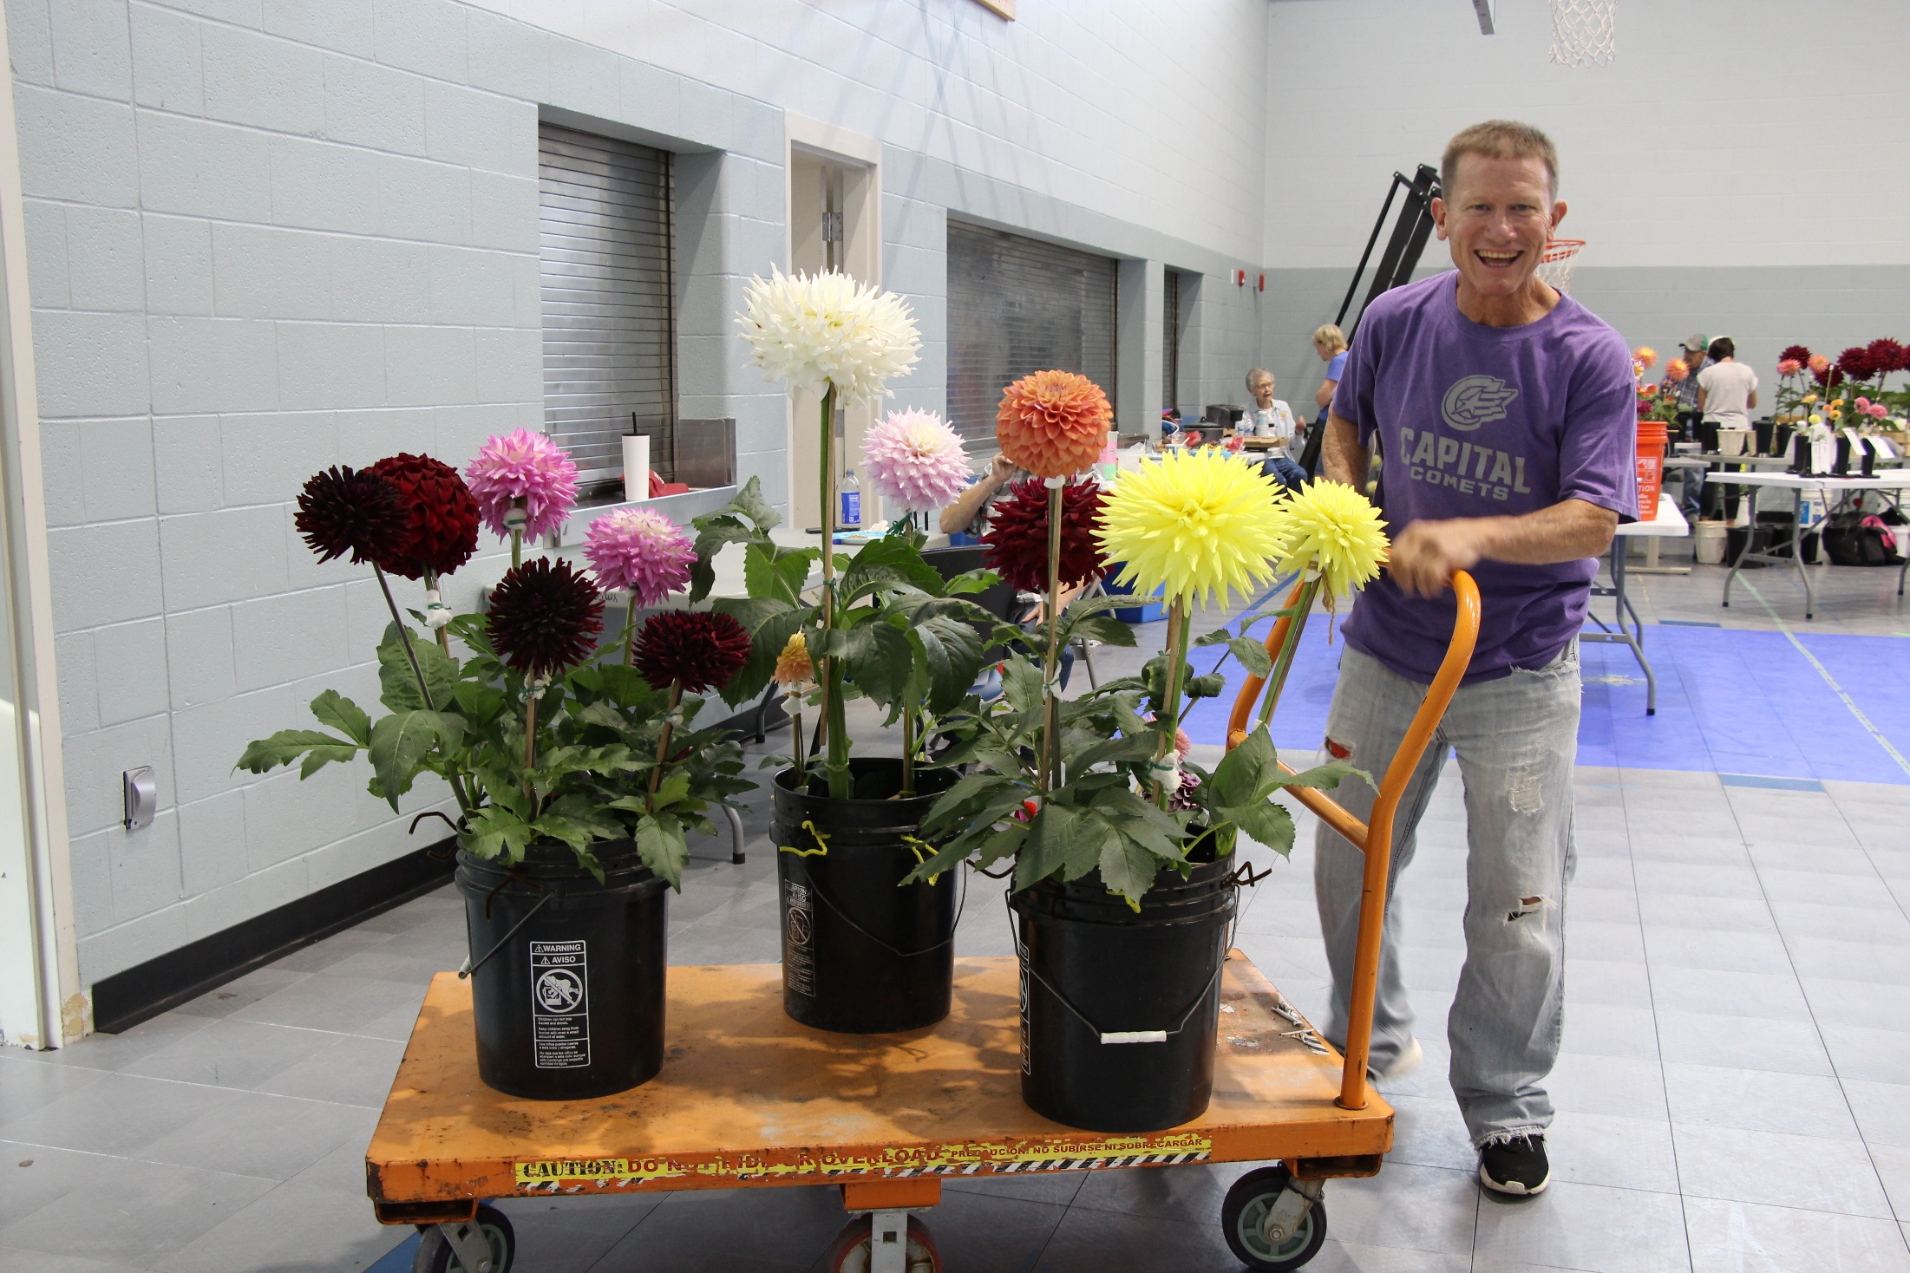
The Dahlias
Arrive

Slide 19
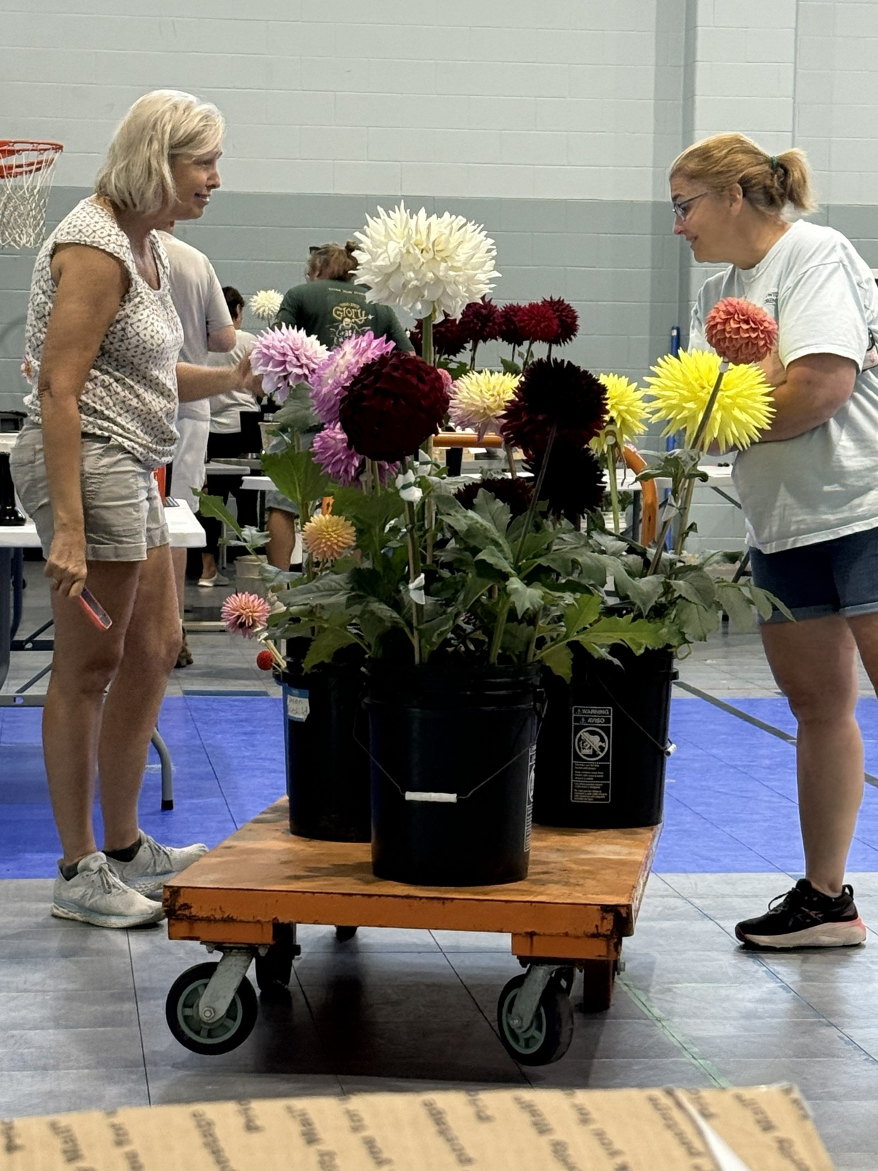

Slide 20
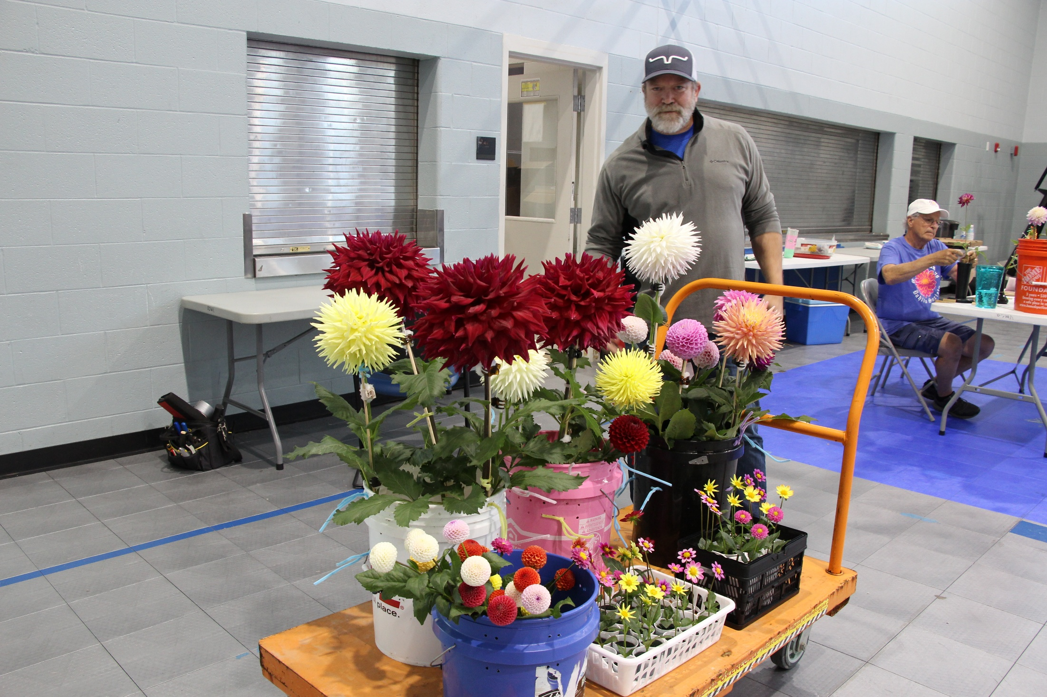

Slide 21
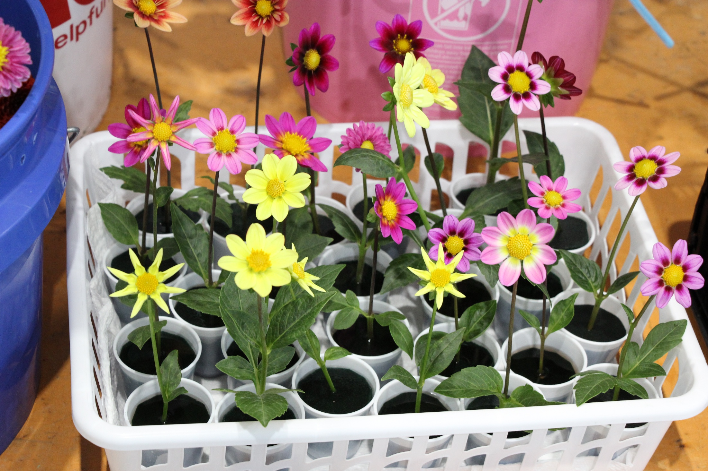

Slide 22
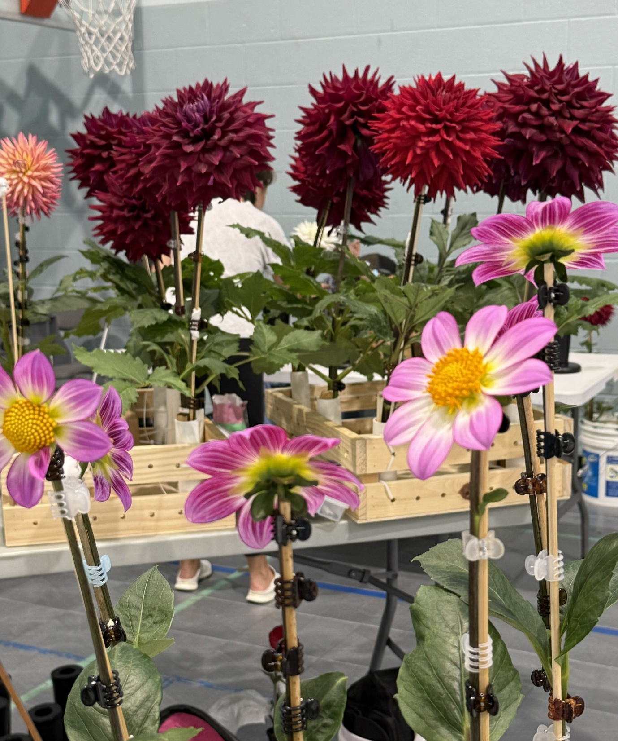

Slide 23
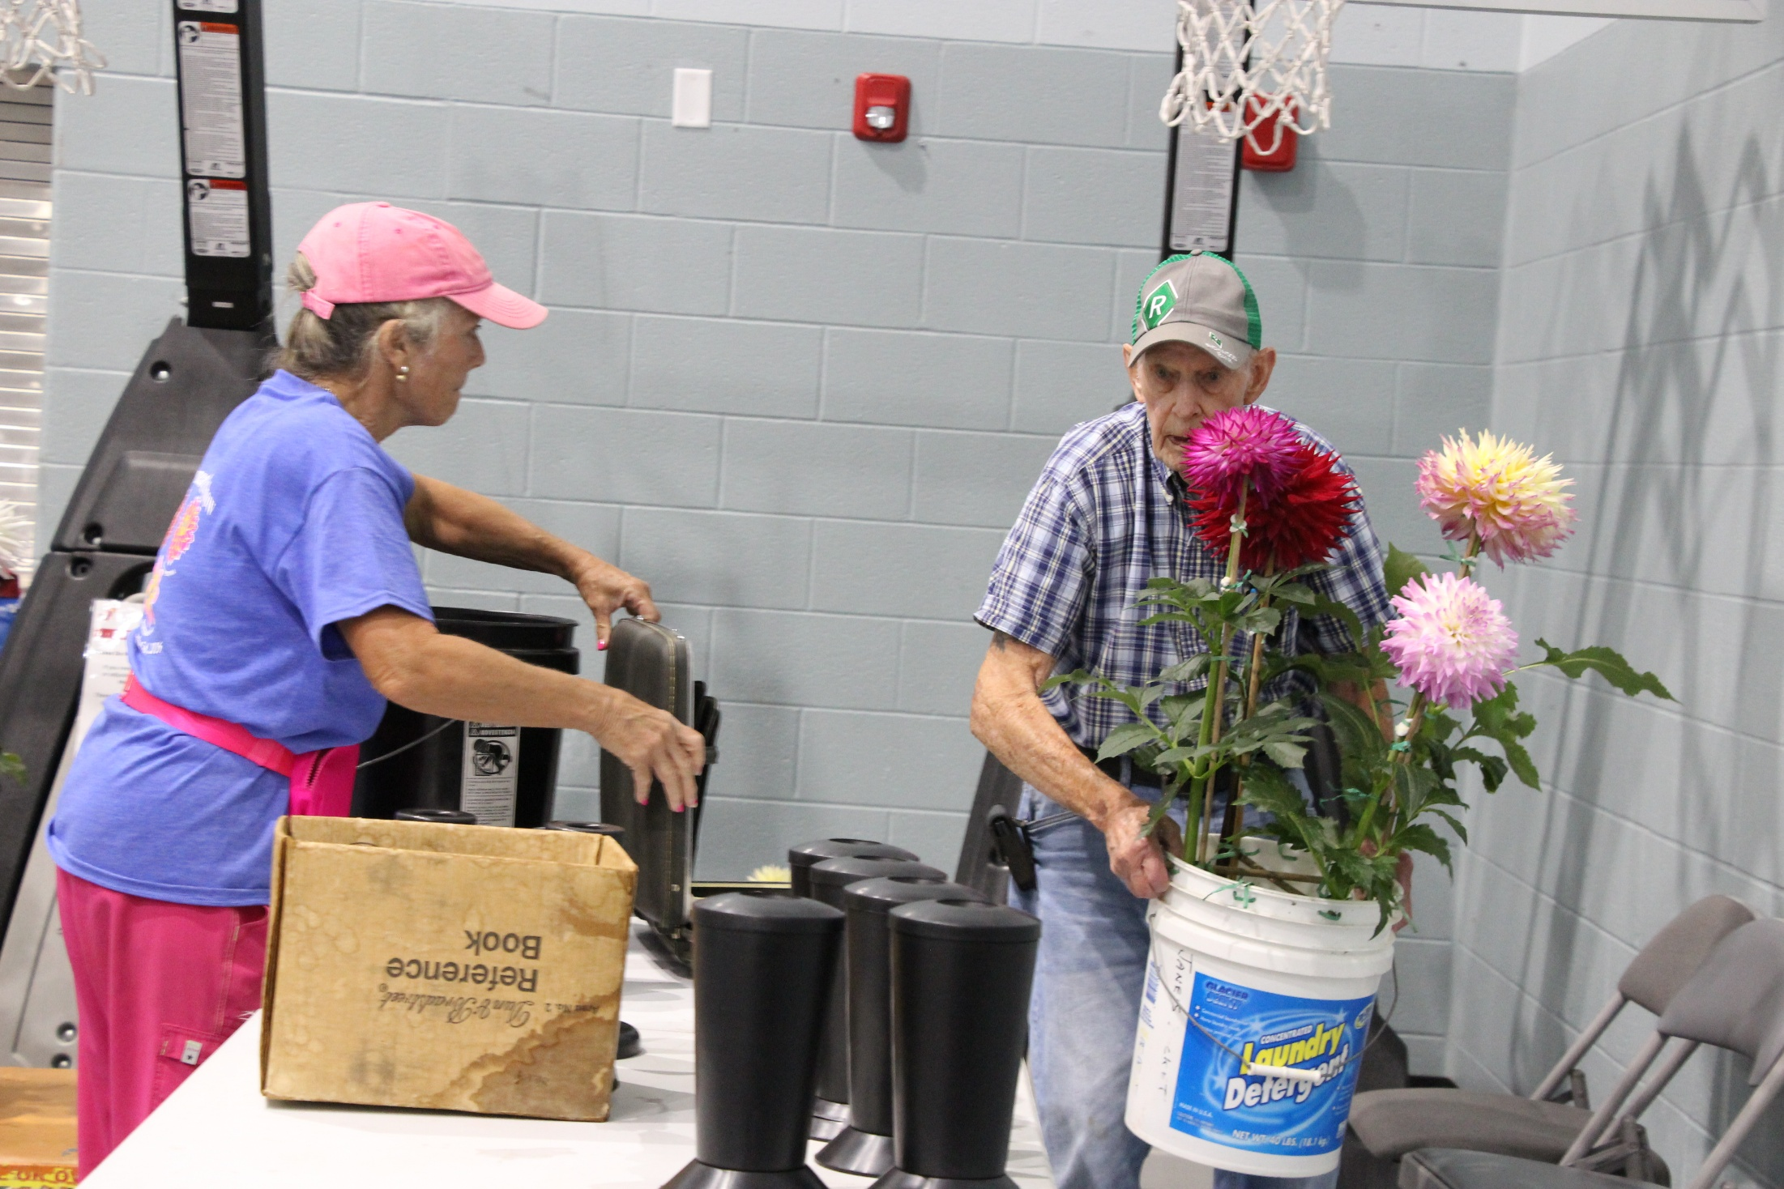

Slide 24
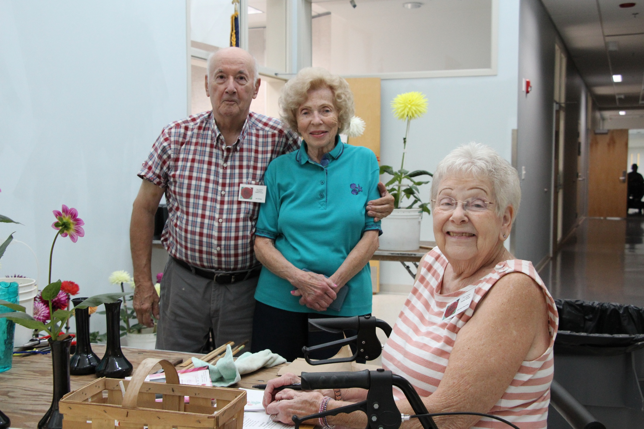

Slide 25
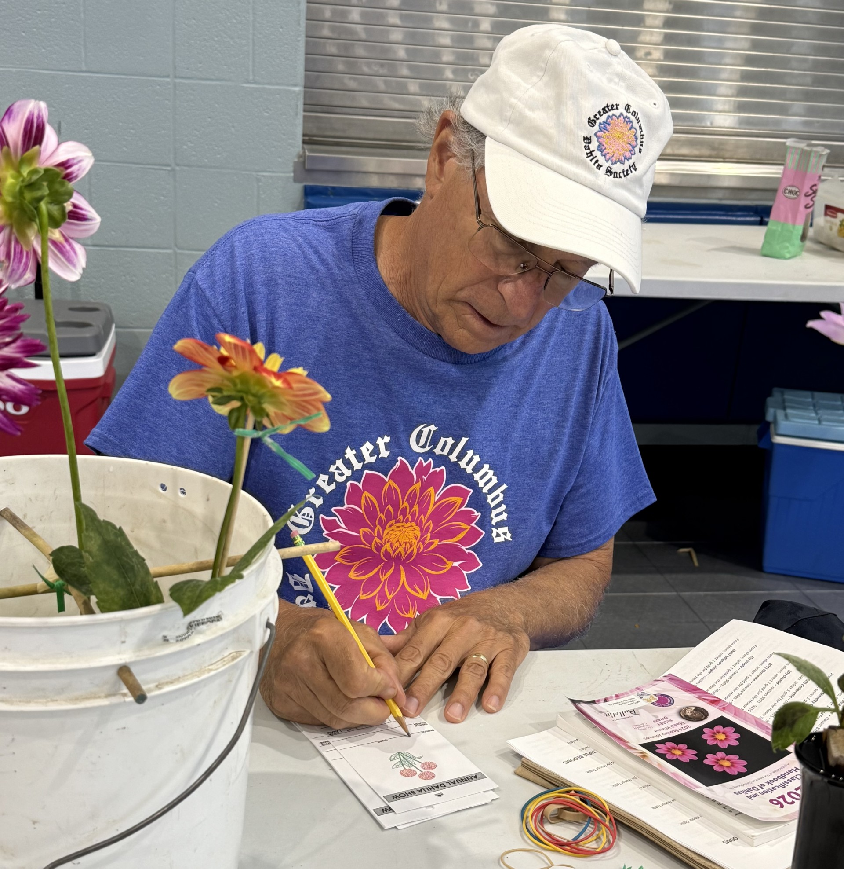

Slide 26
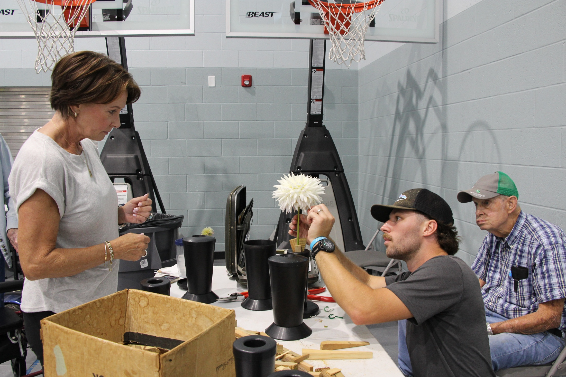

Slide 27
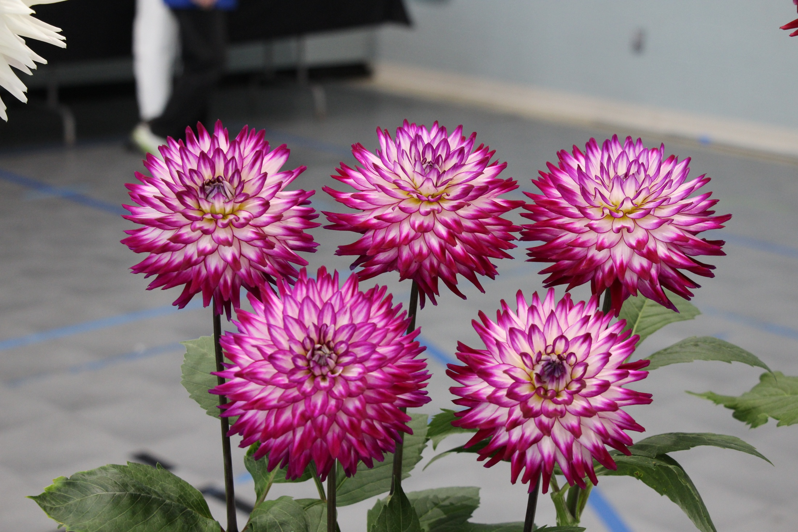

Slide 28
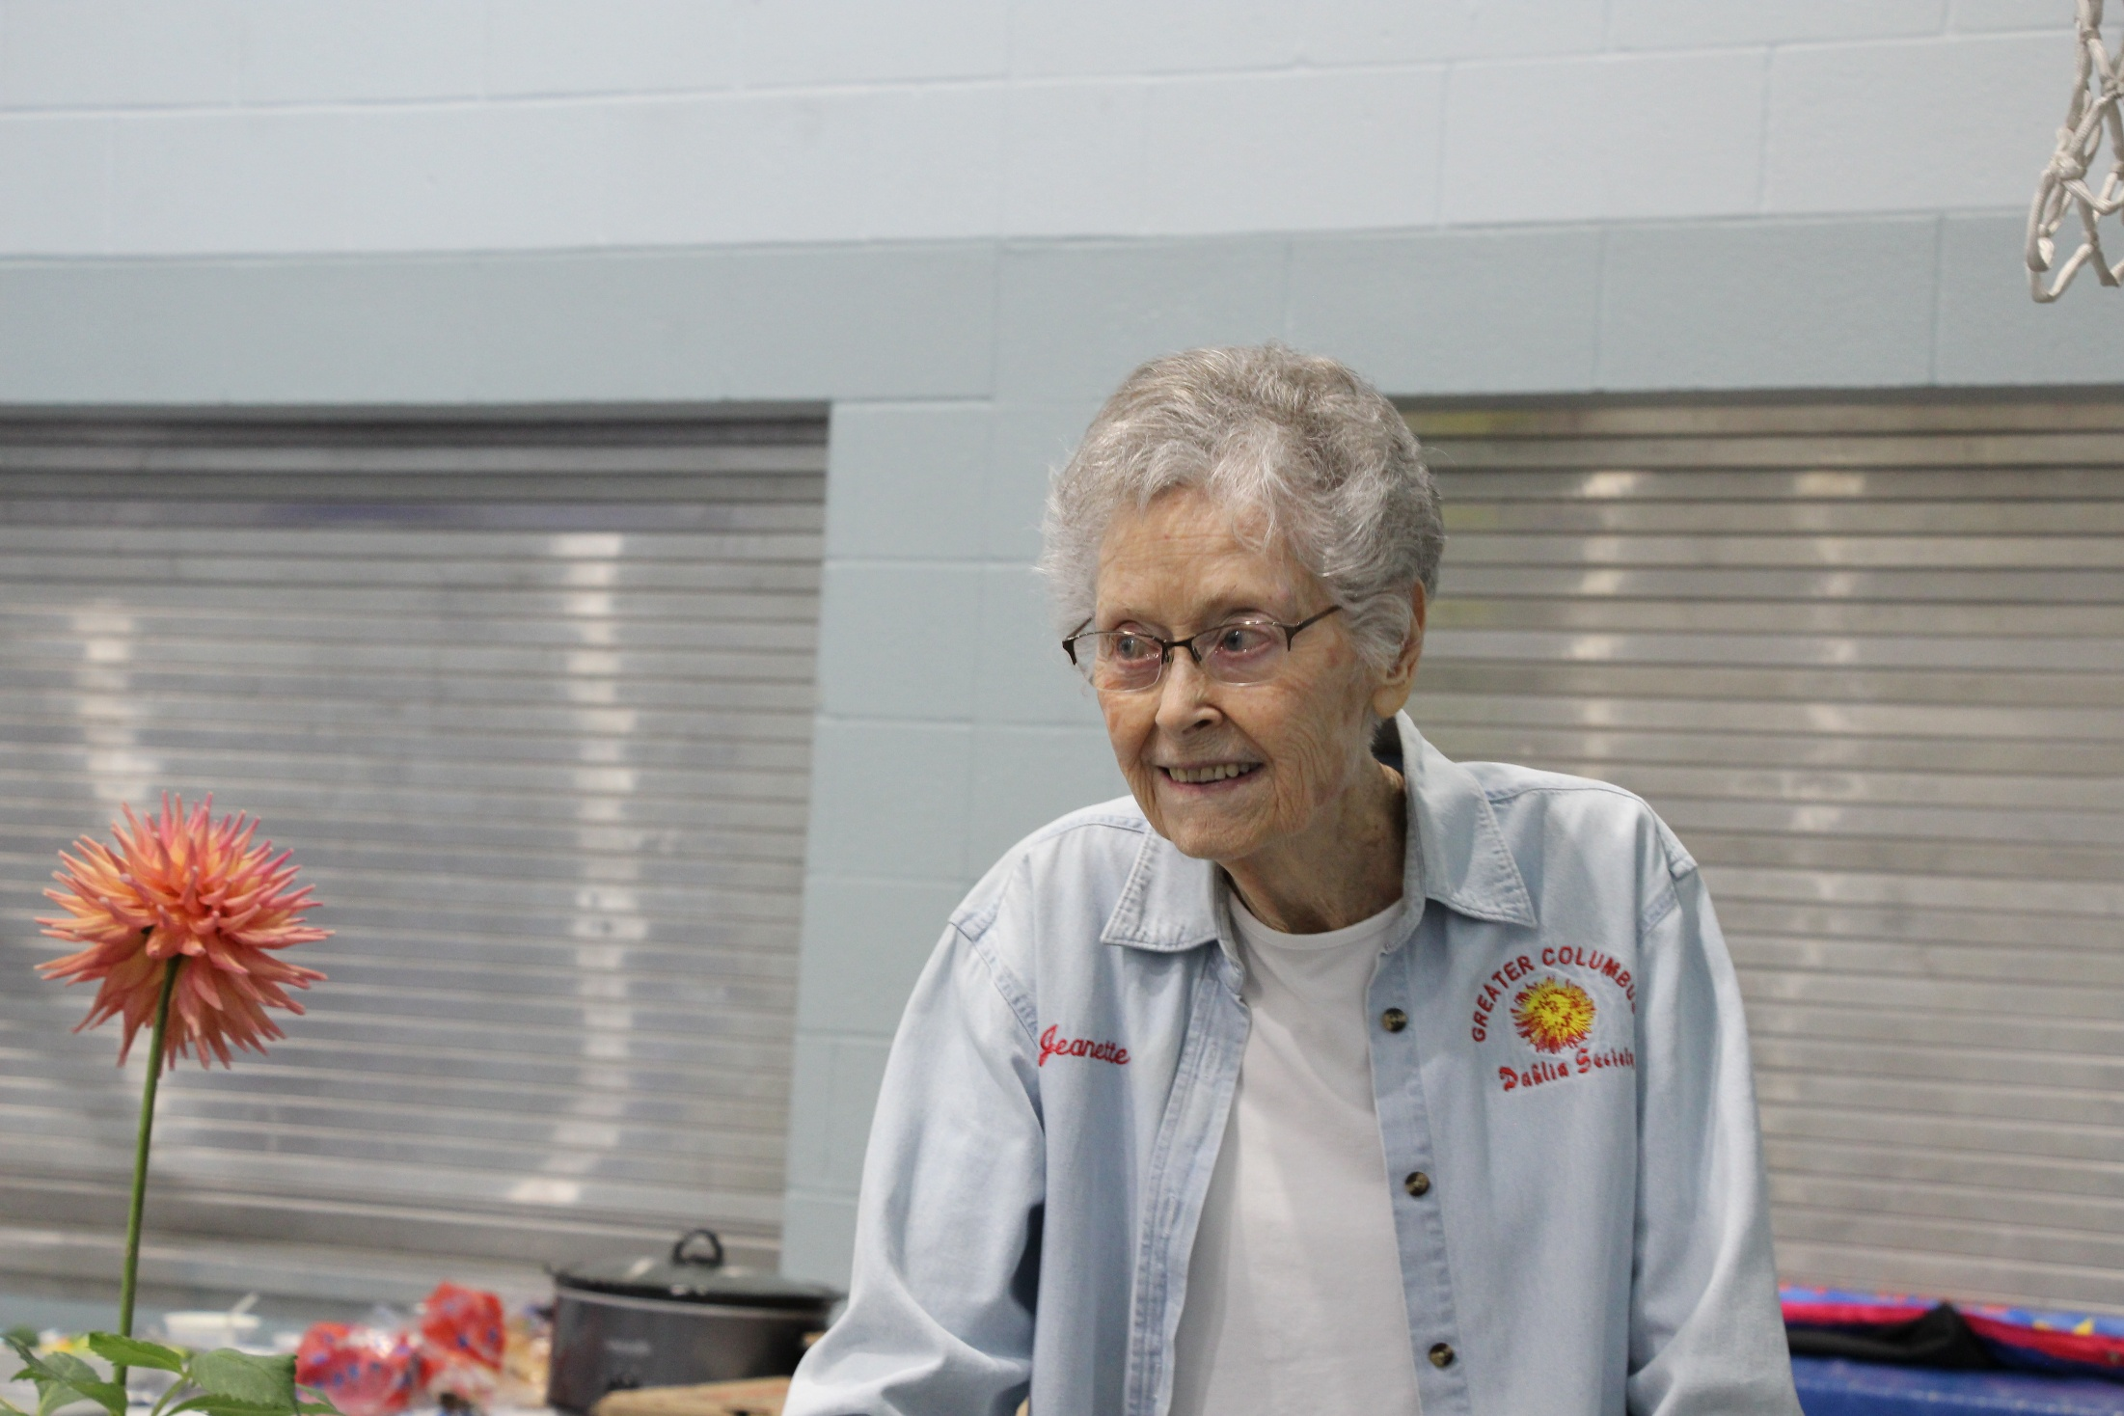

Slide 29
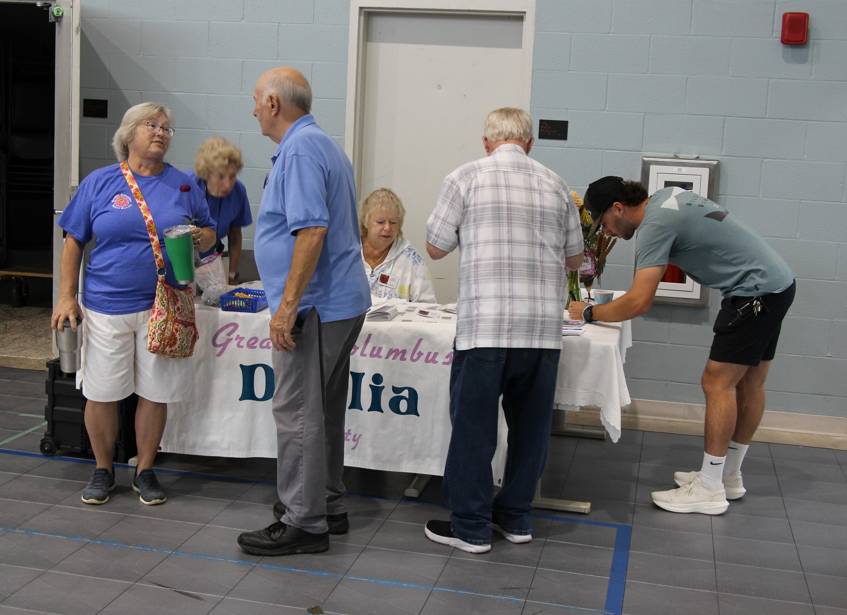

Slide 30
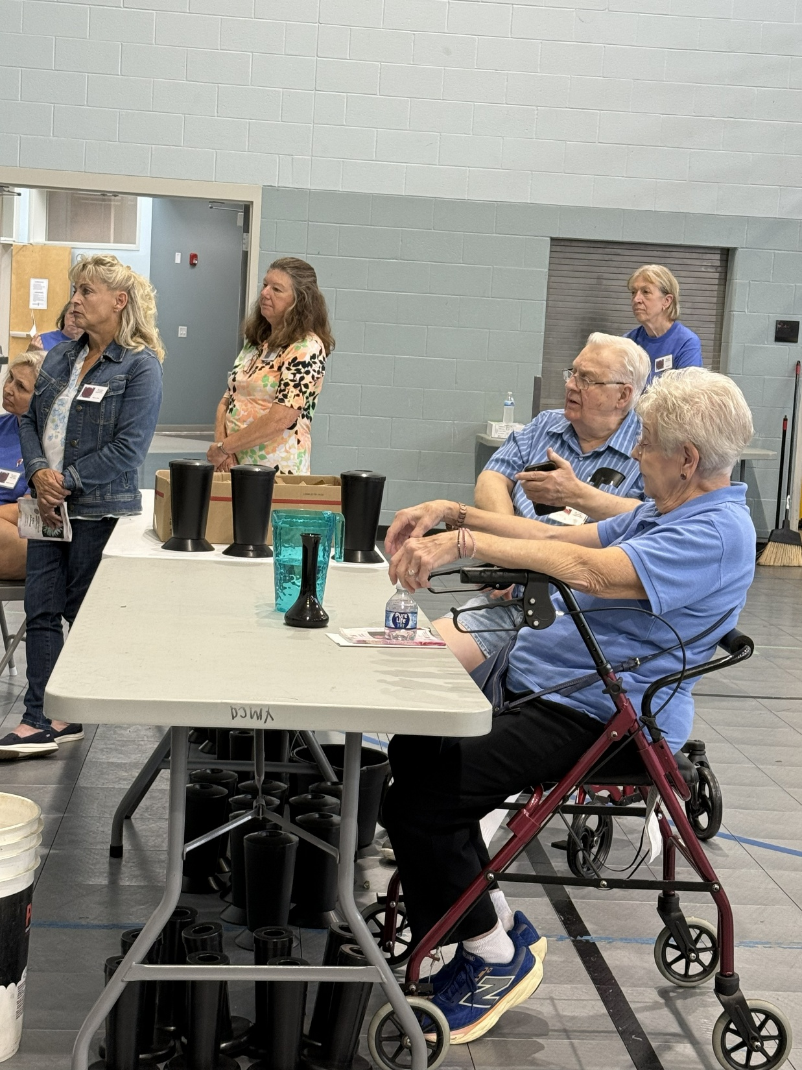
The Judging

Slide 31
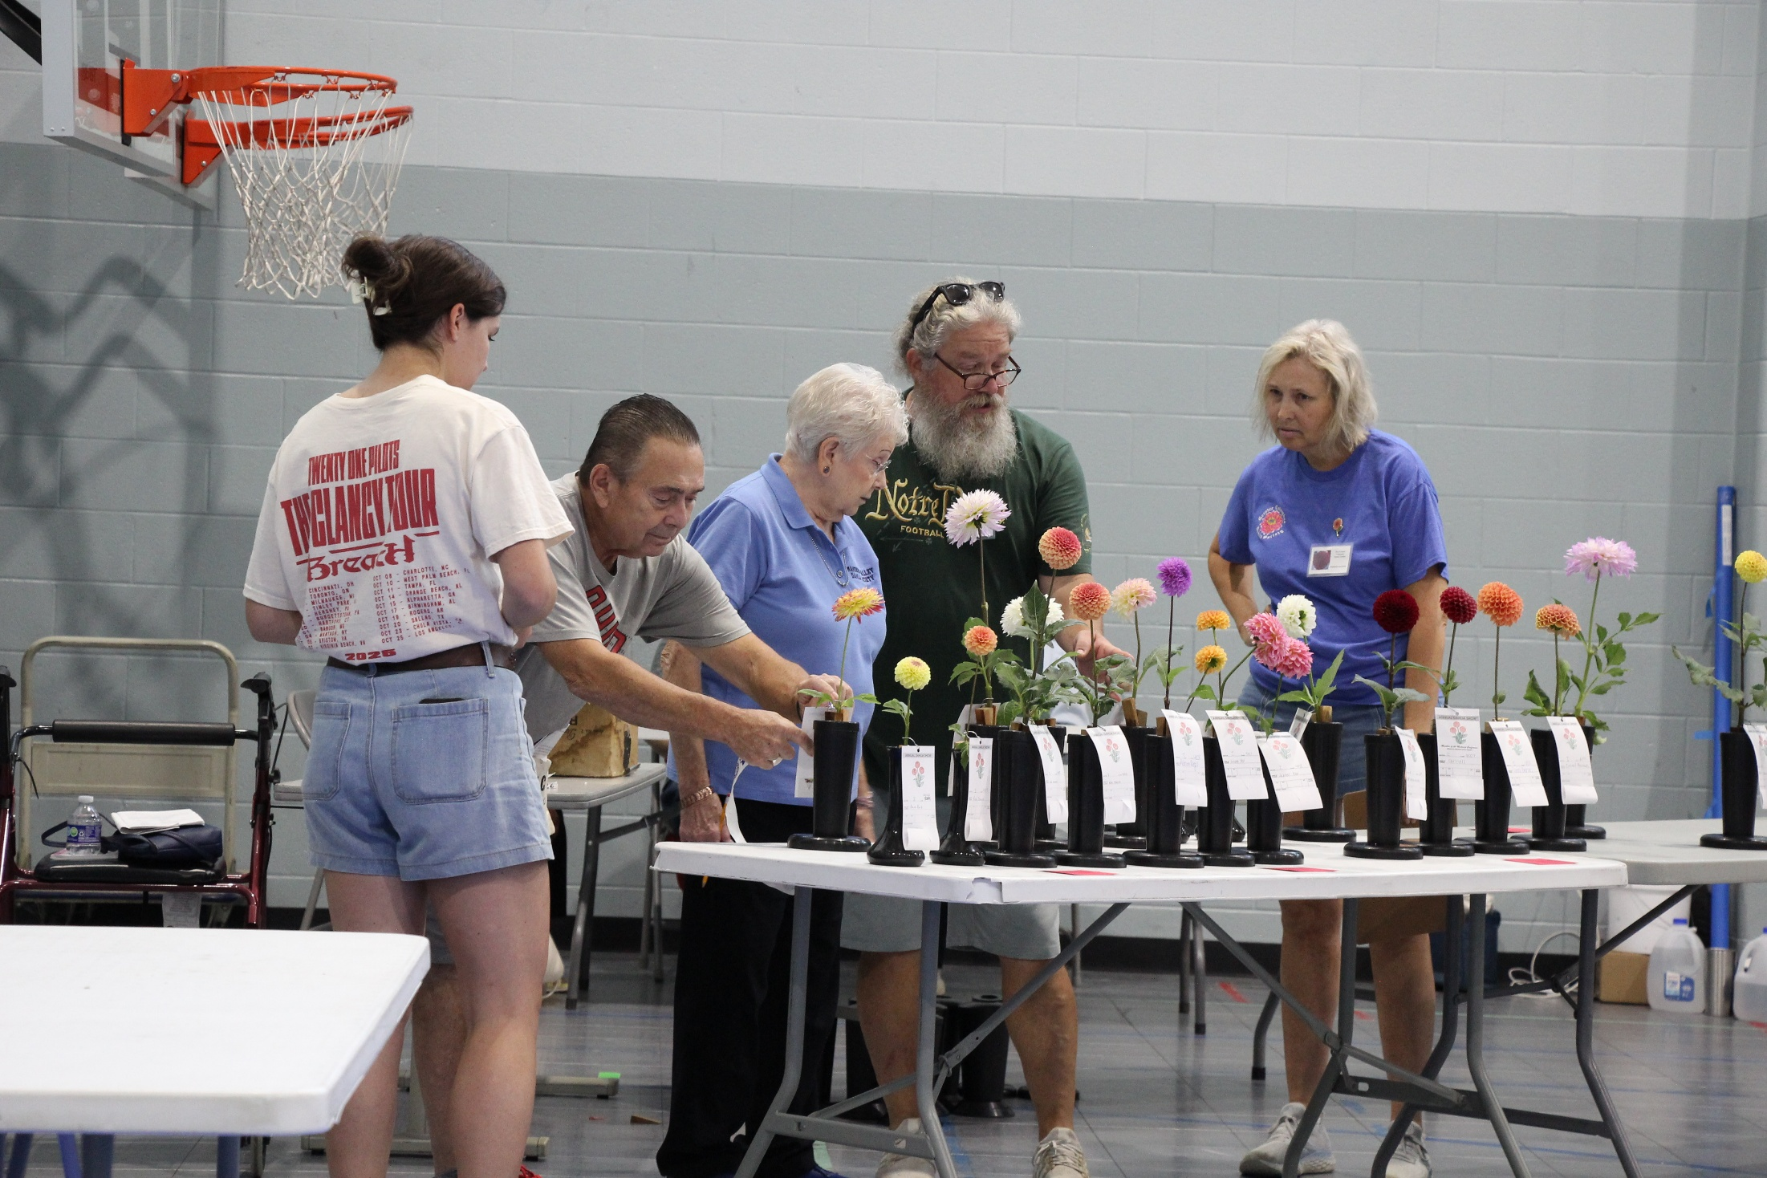

Slide 32
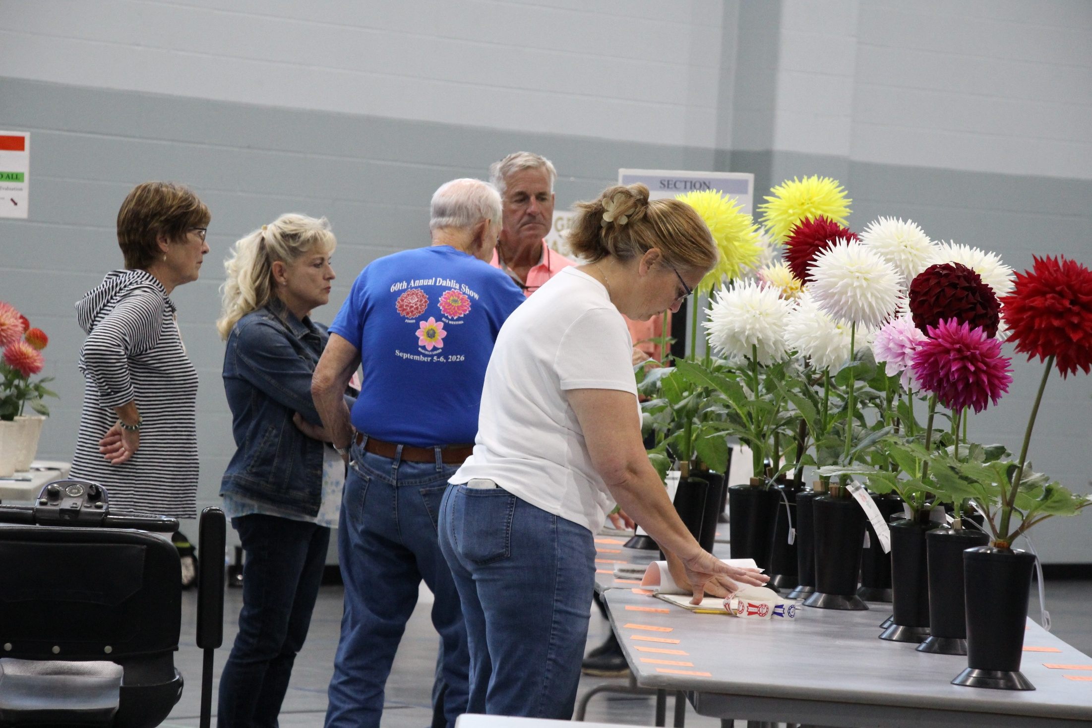

Slide 33
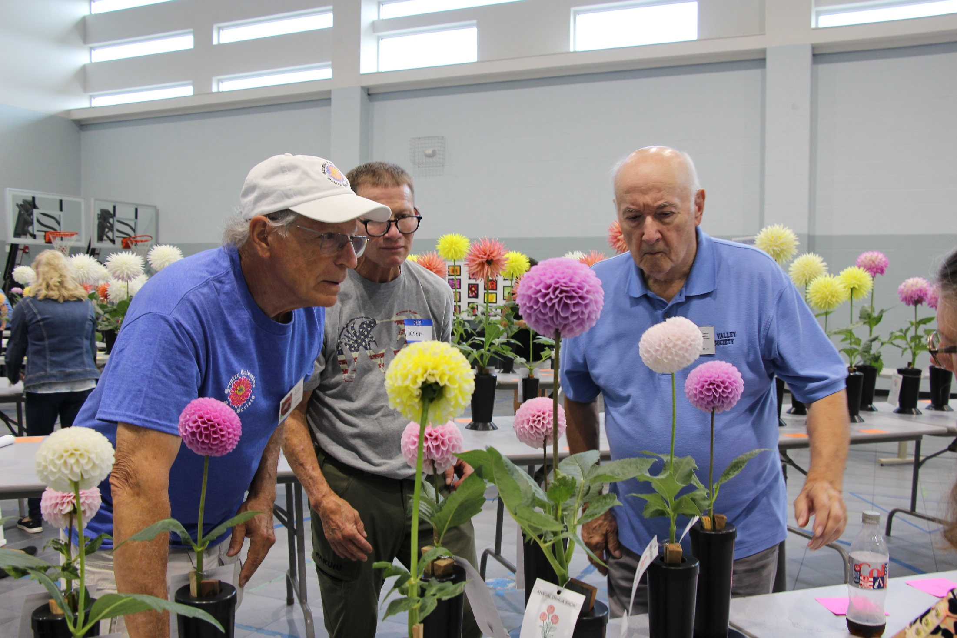

Slide 34
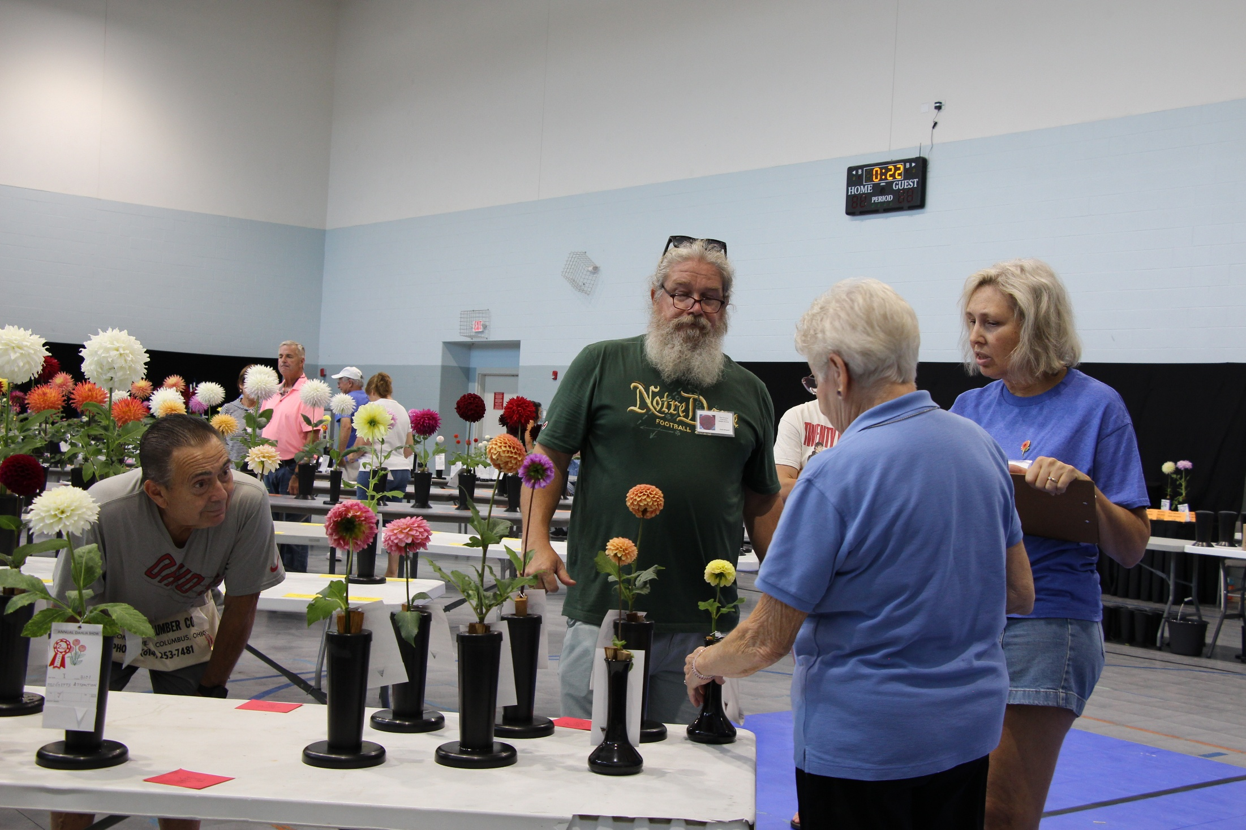

Slide 35
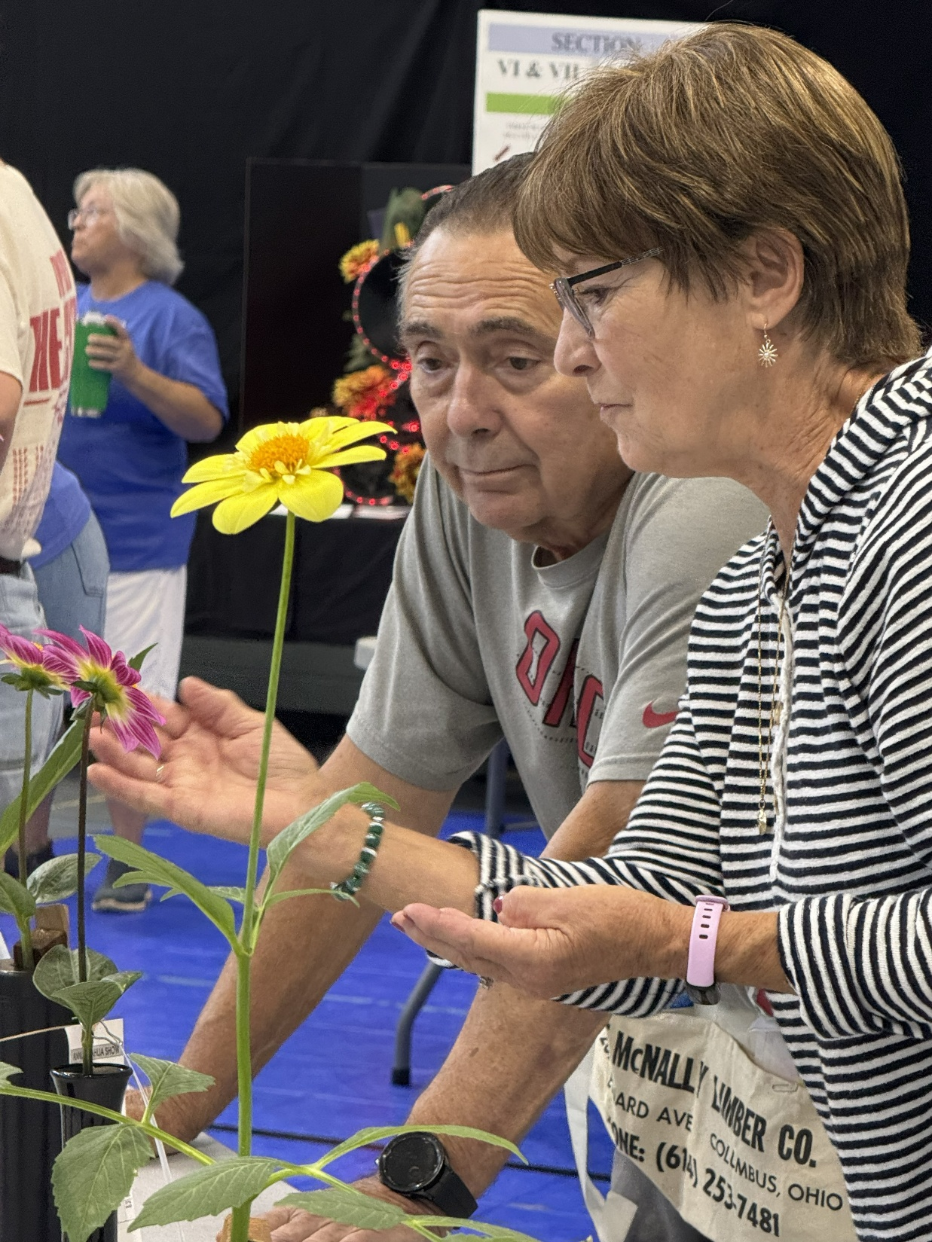

Slide 36
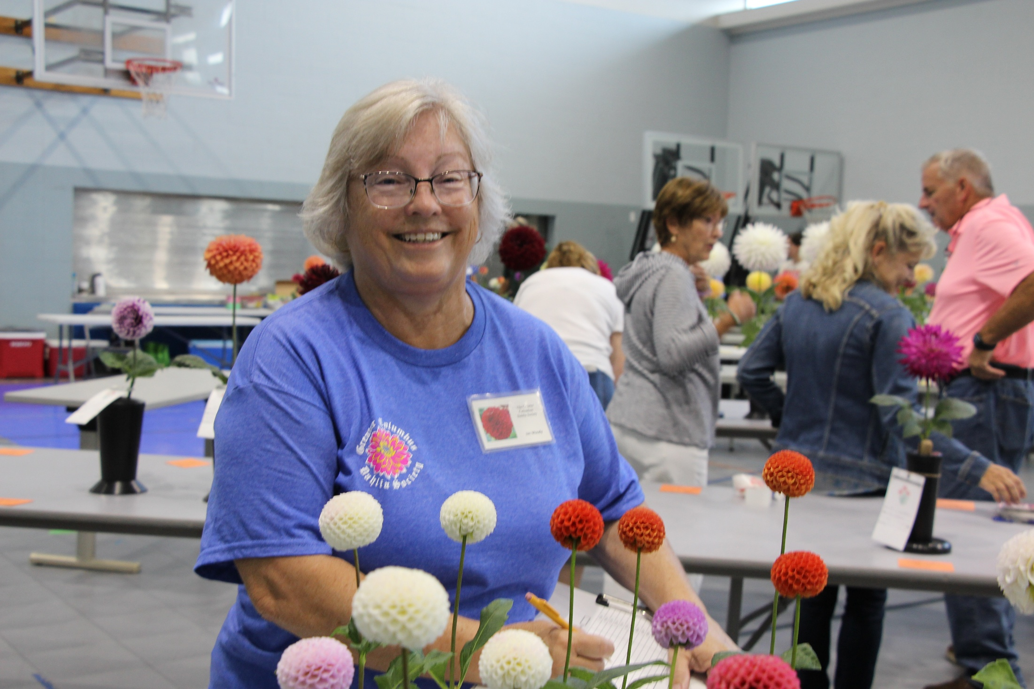

Slide 37
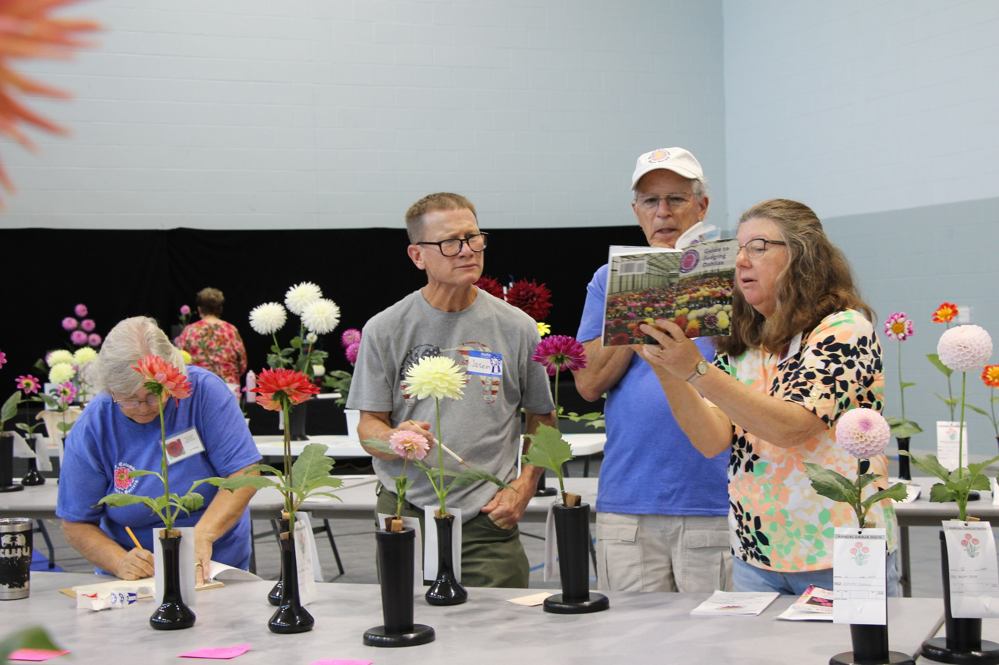

Slide 38
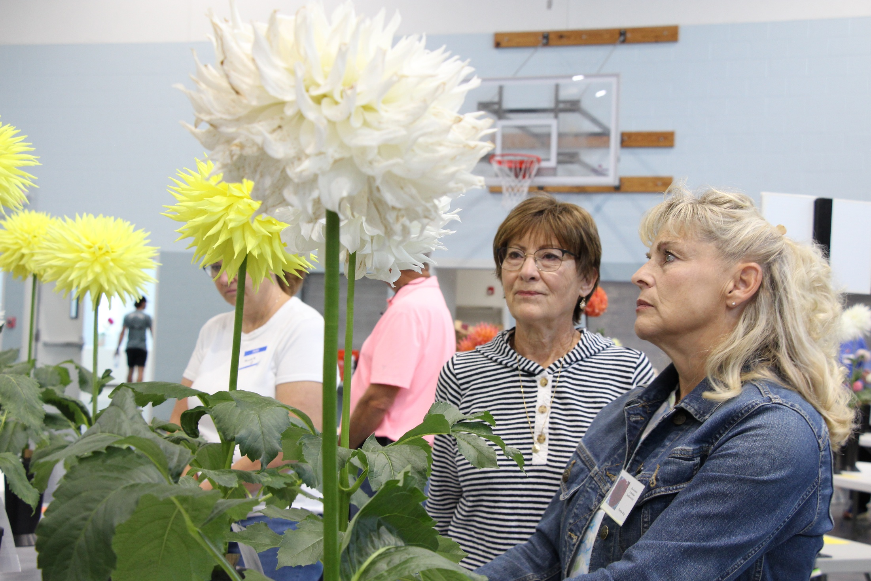

Slide 39
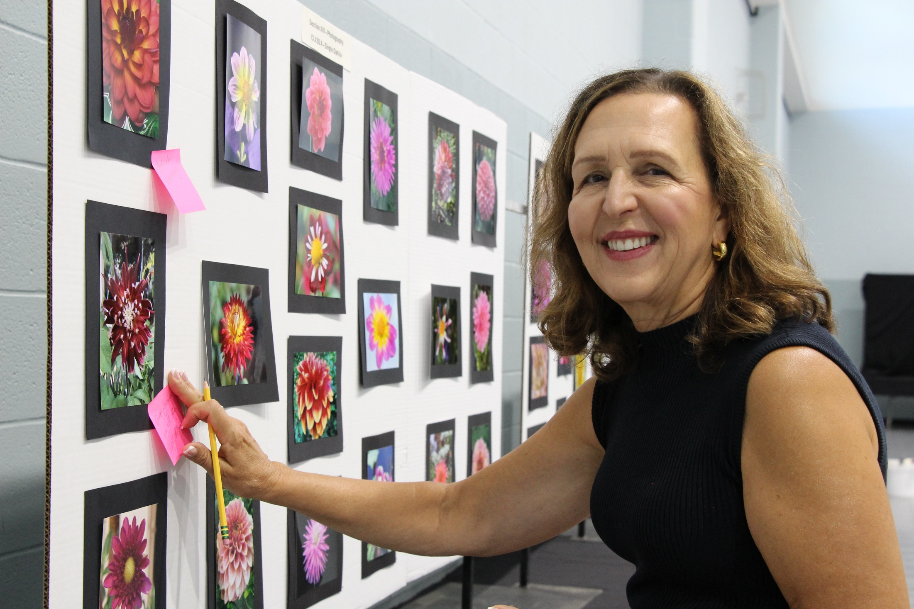

Slide 40
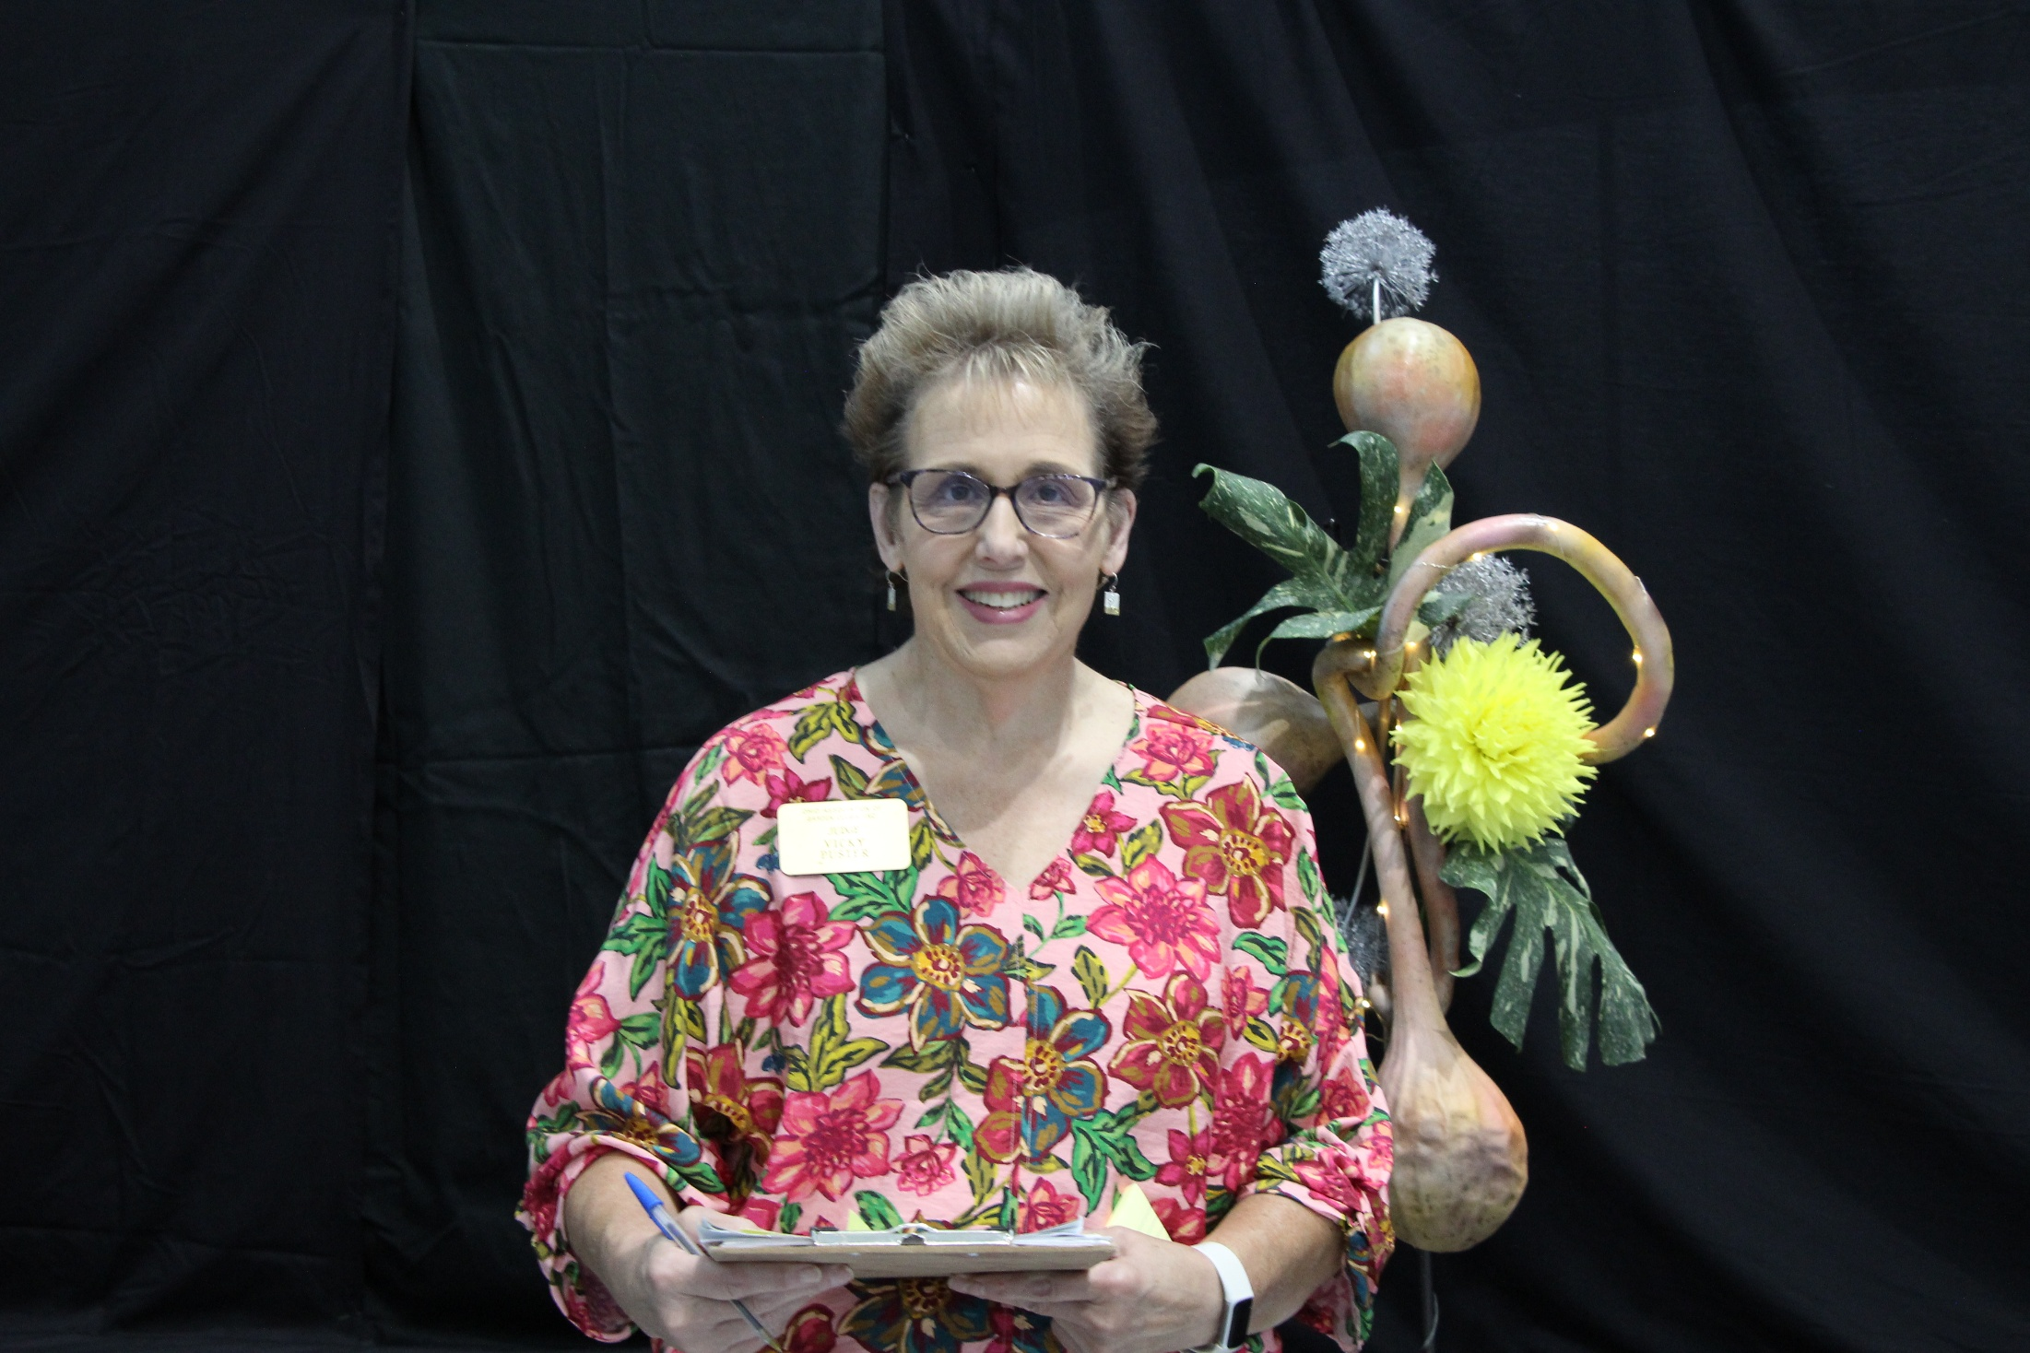

Slide 41
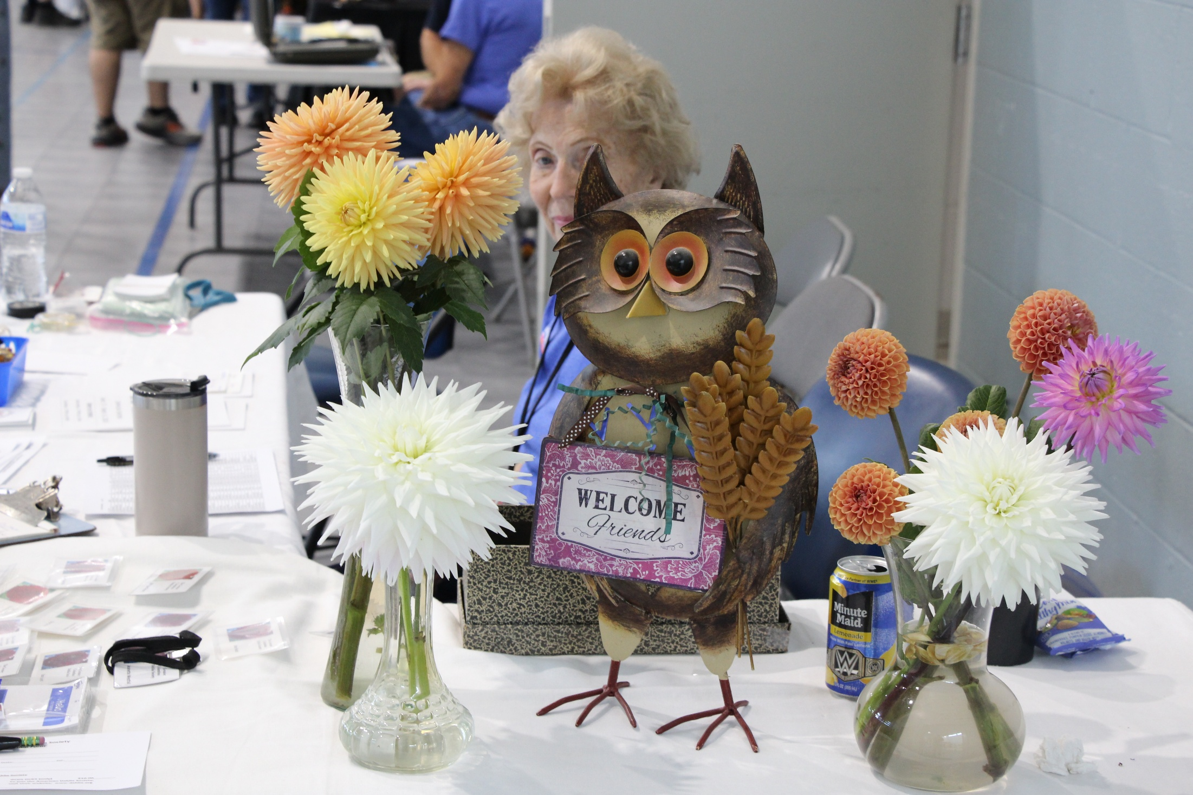
The Show

Slide 42
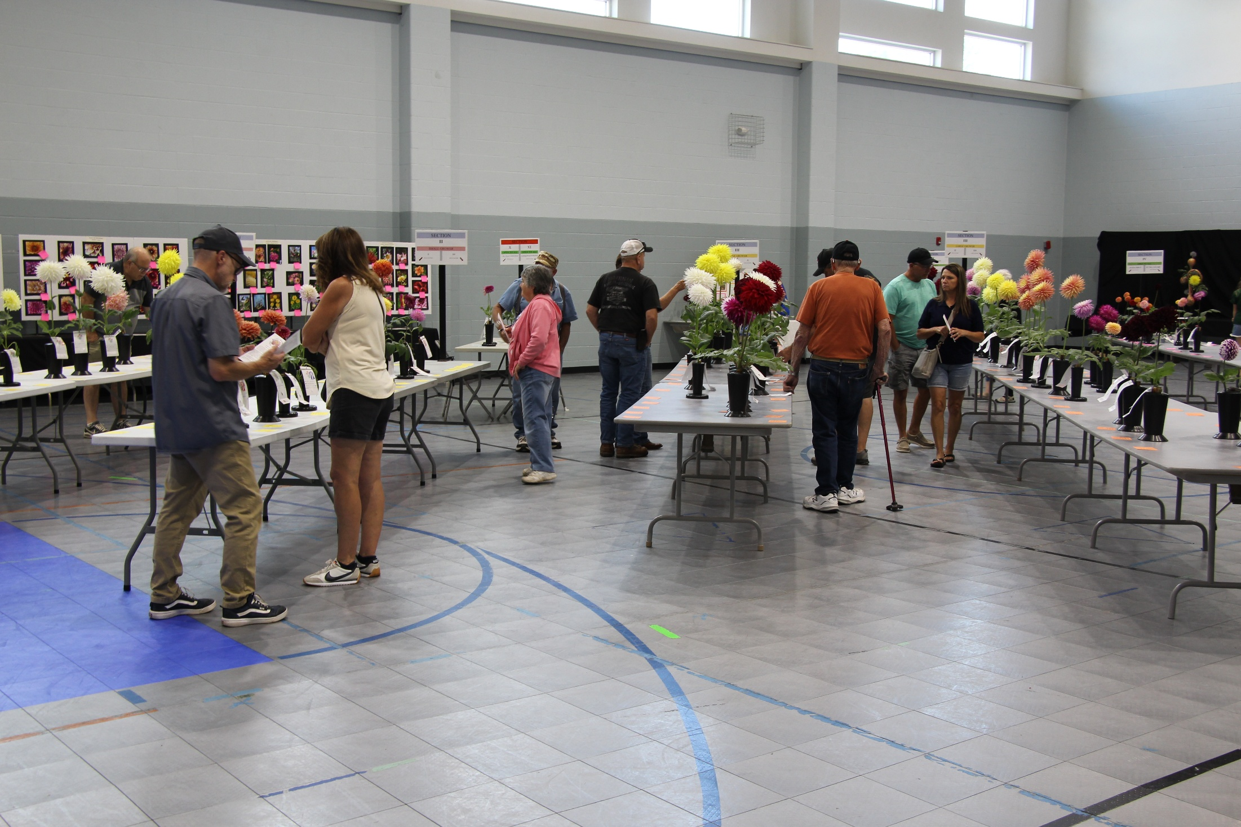

Slide 43
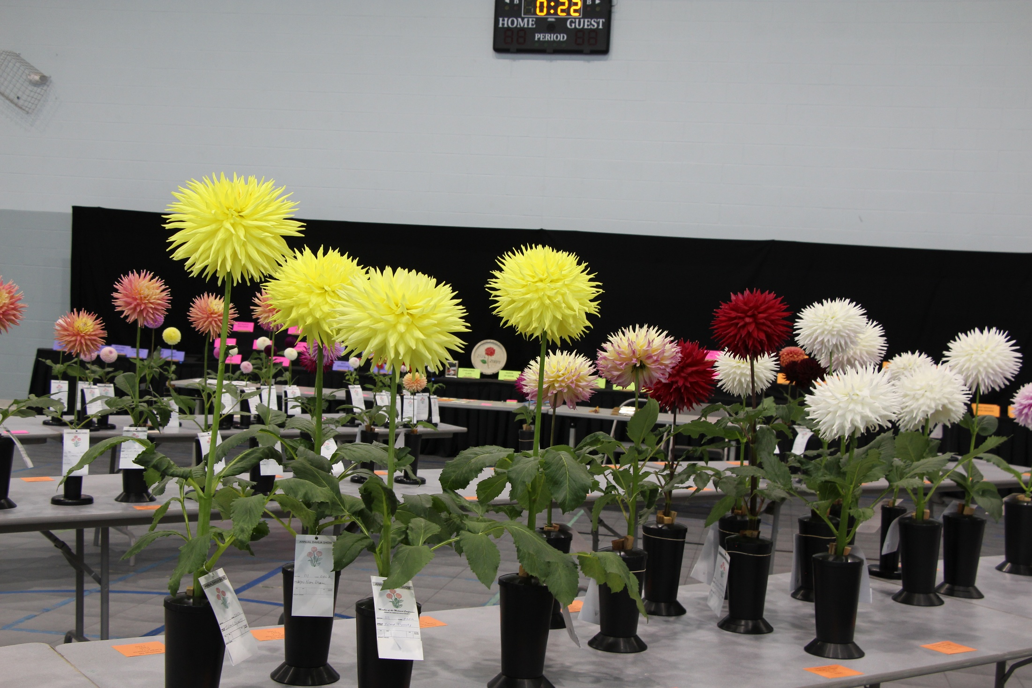

Slide 44
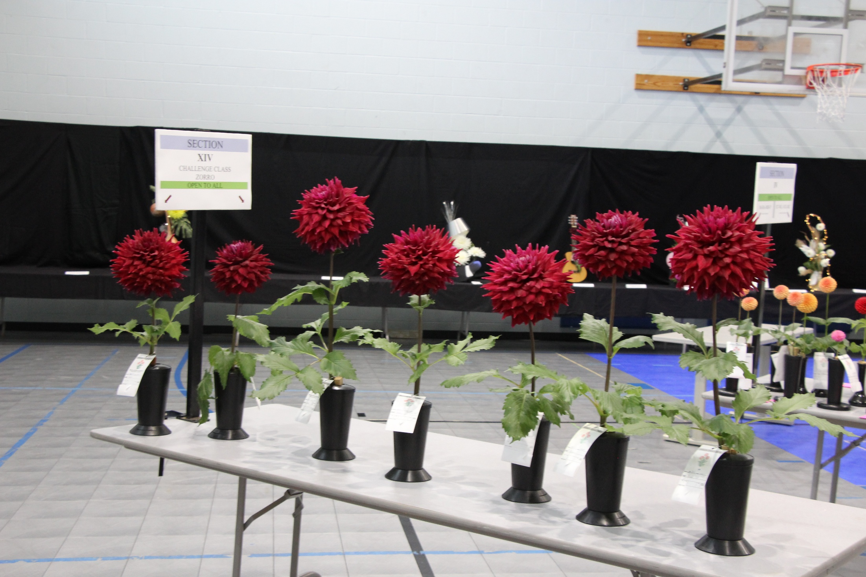

Slide 45
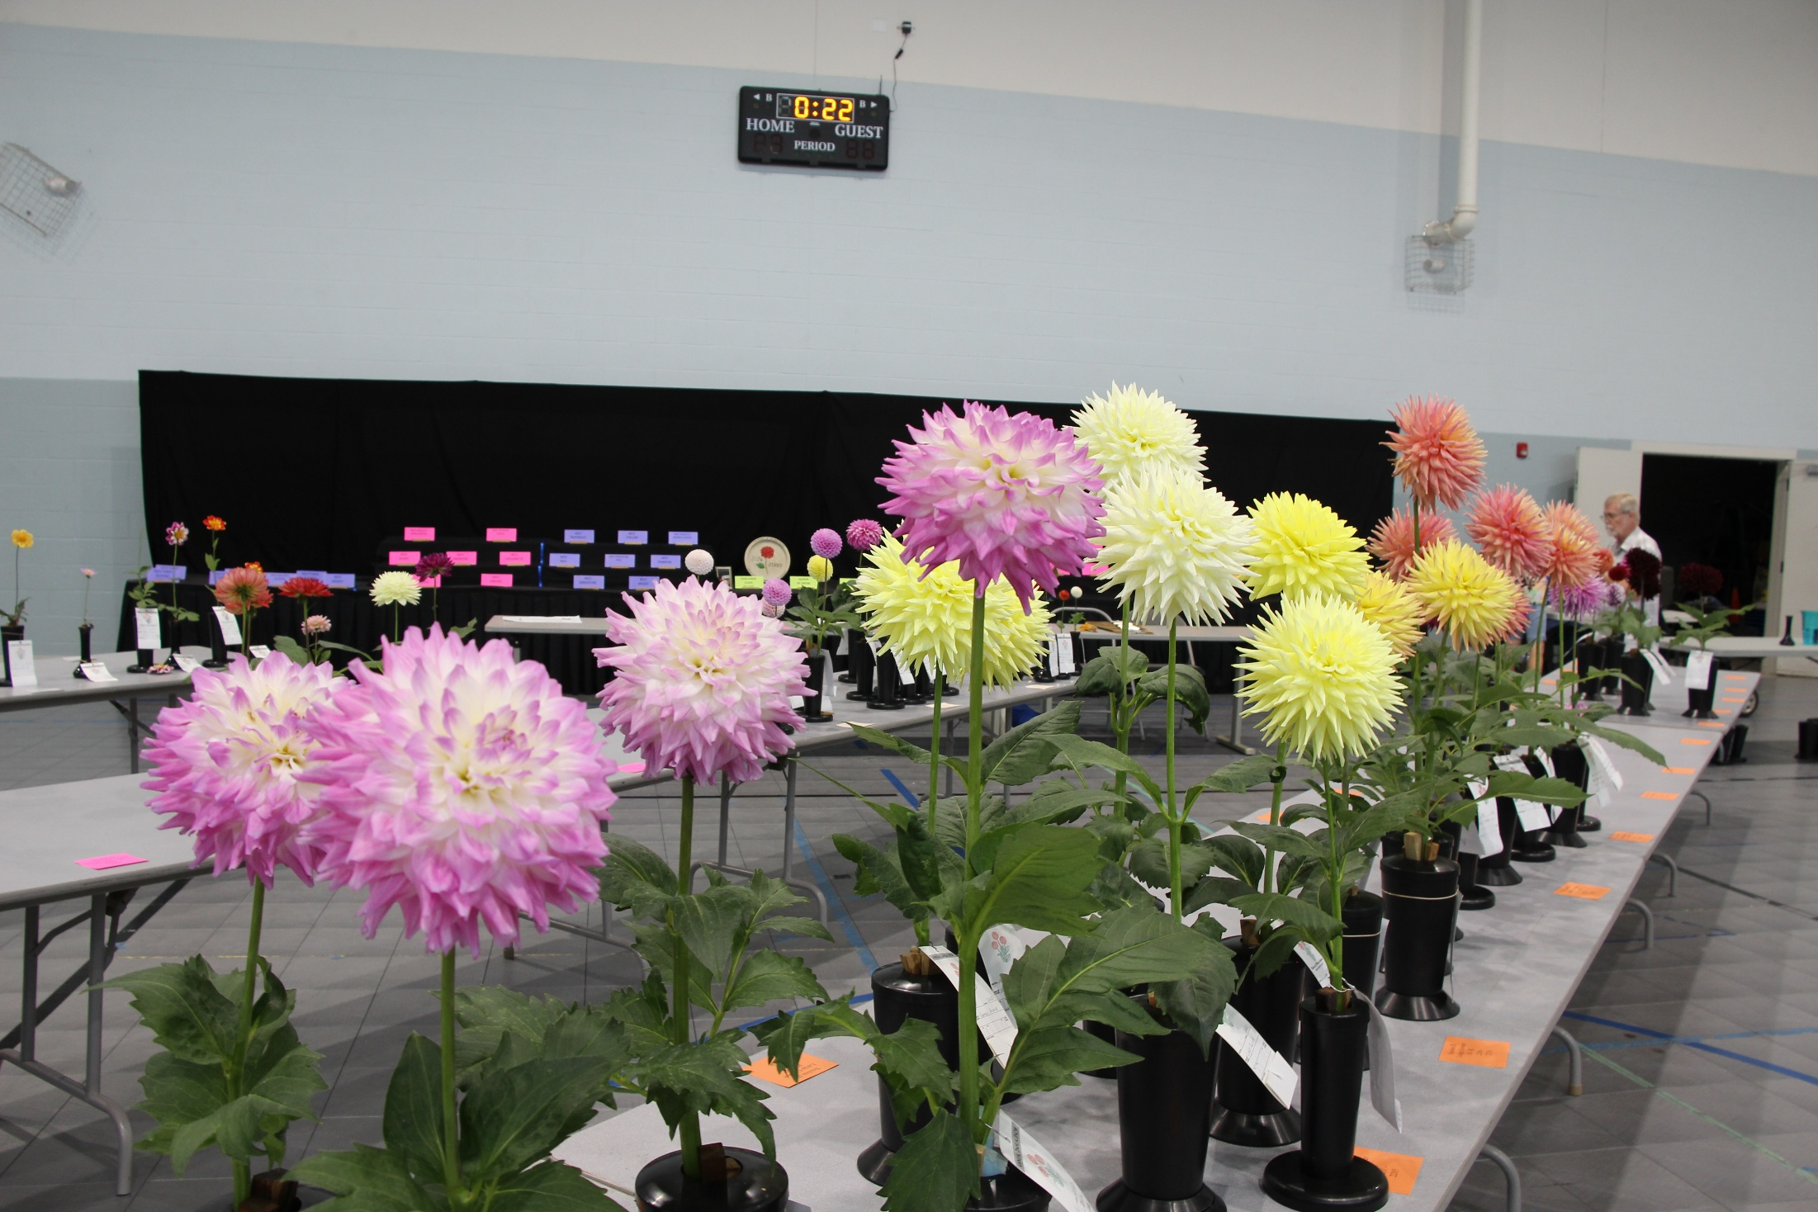

Slide 46
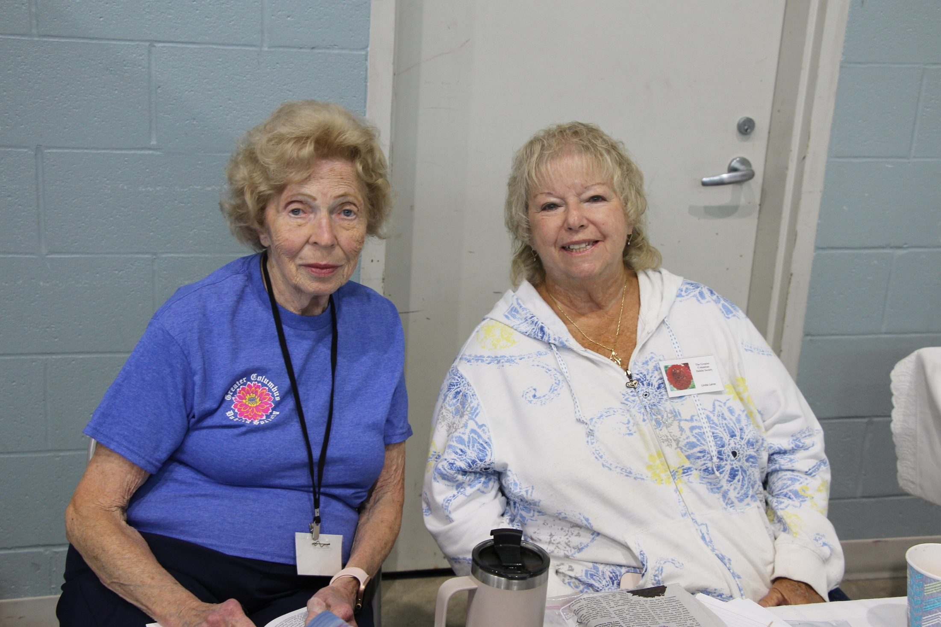

Slide 47
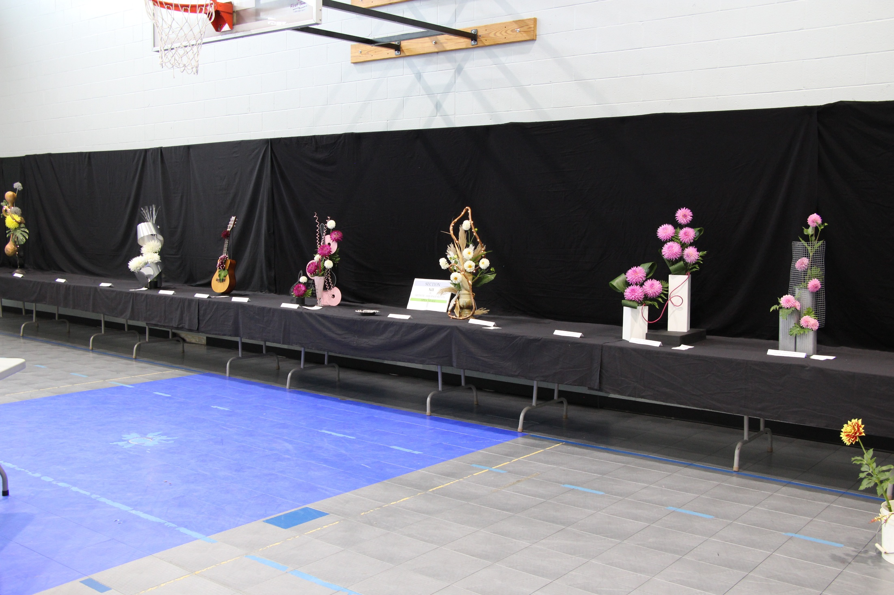

Slide 48
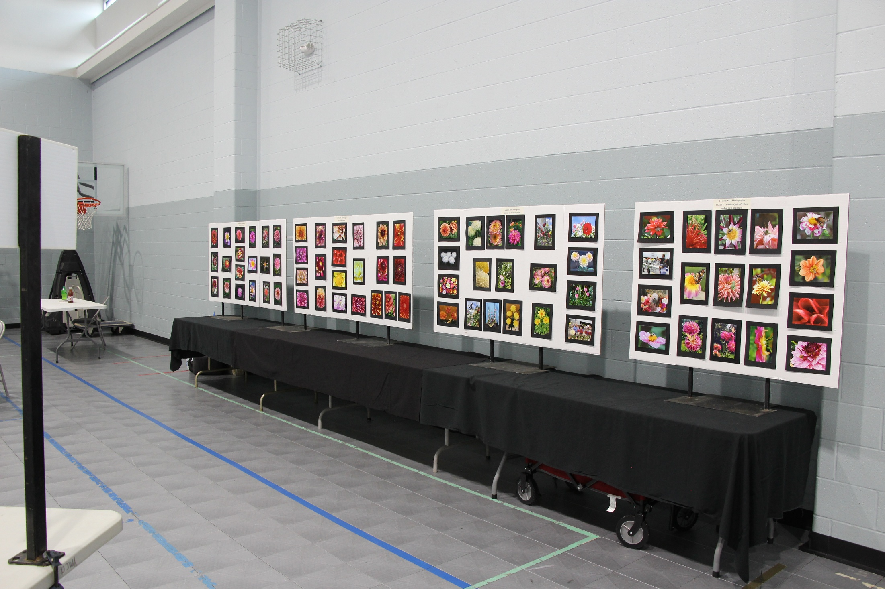

Slide 49
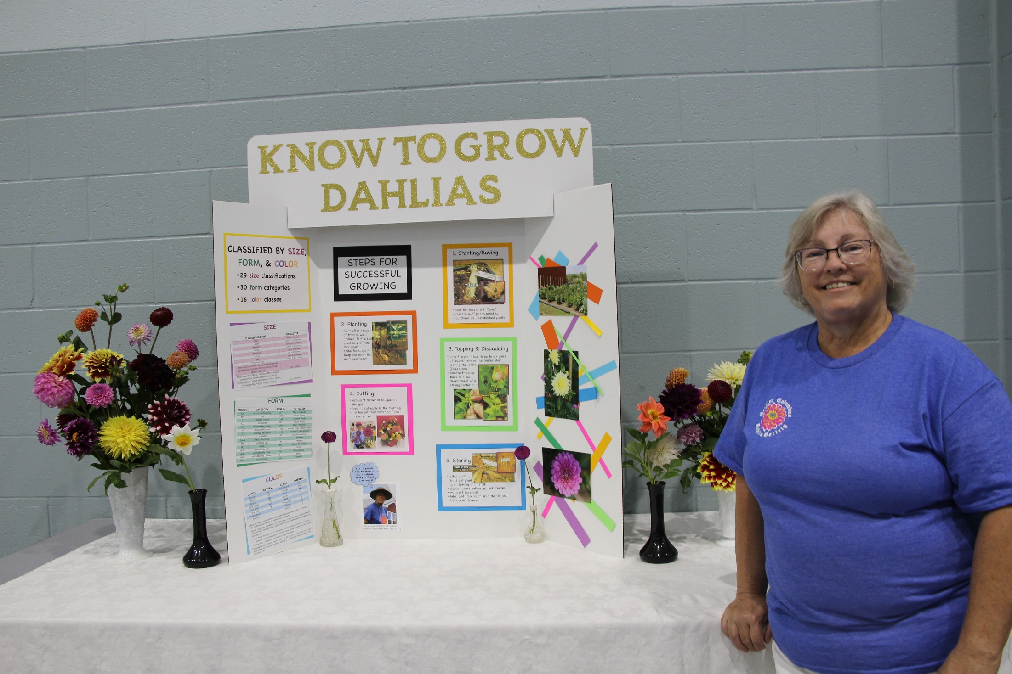

Slide 50
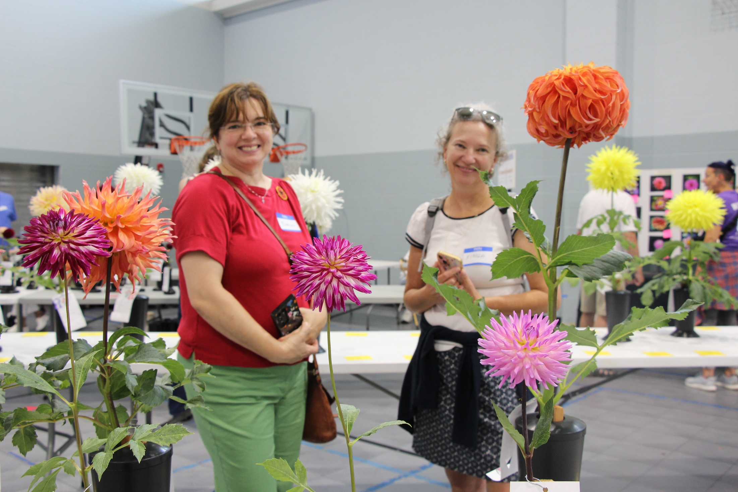

Slide 52
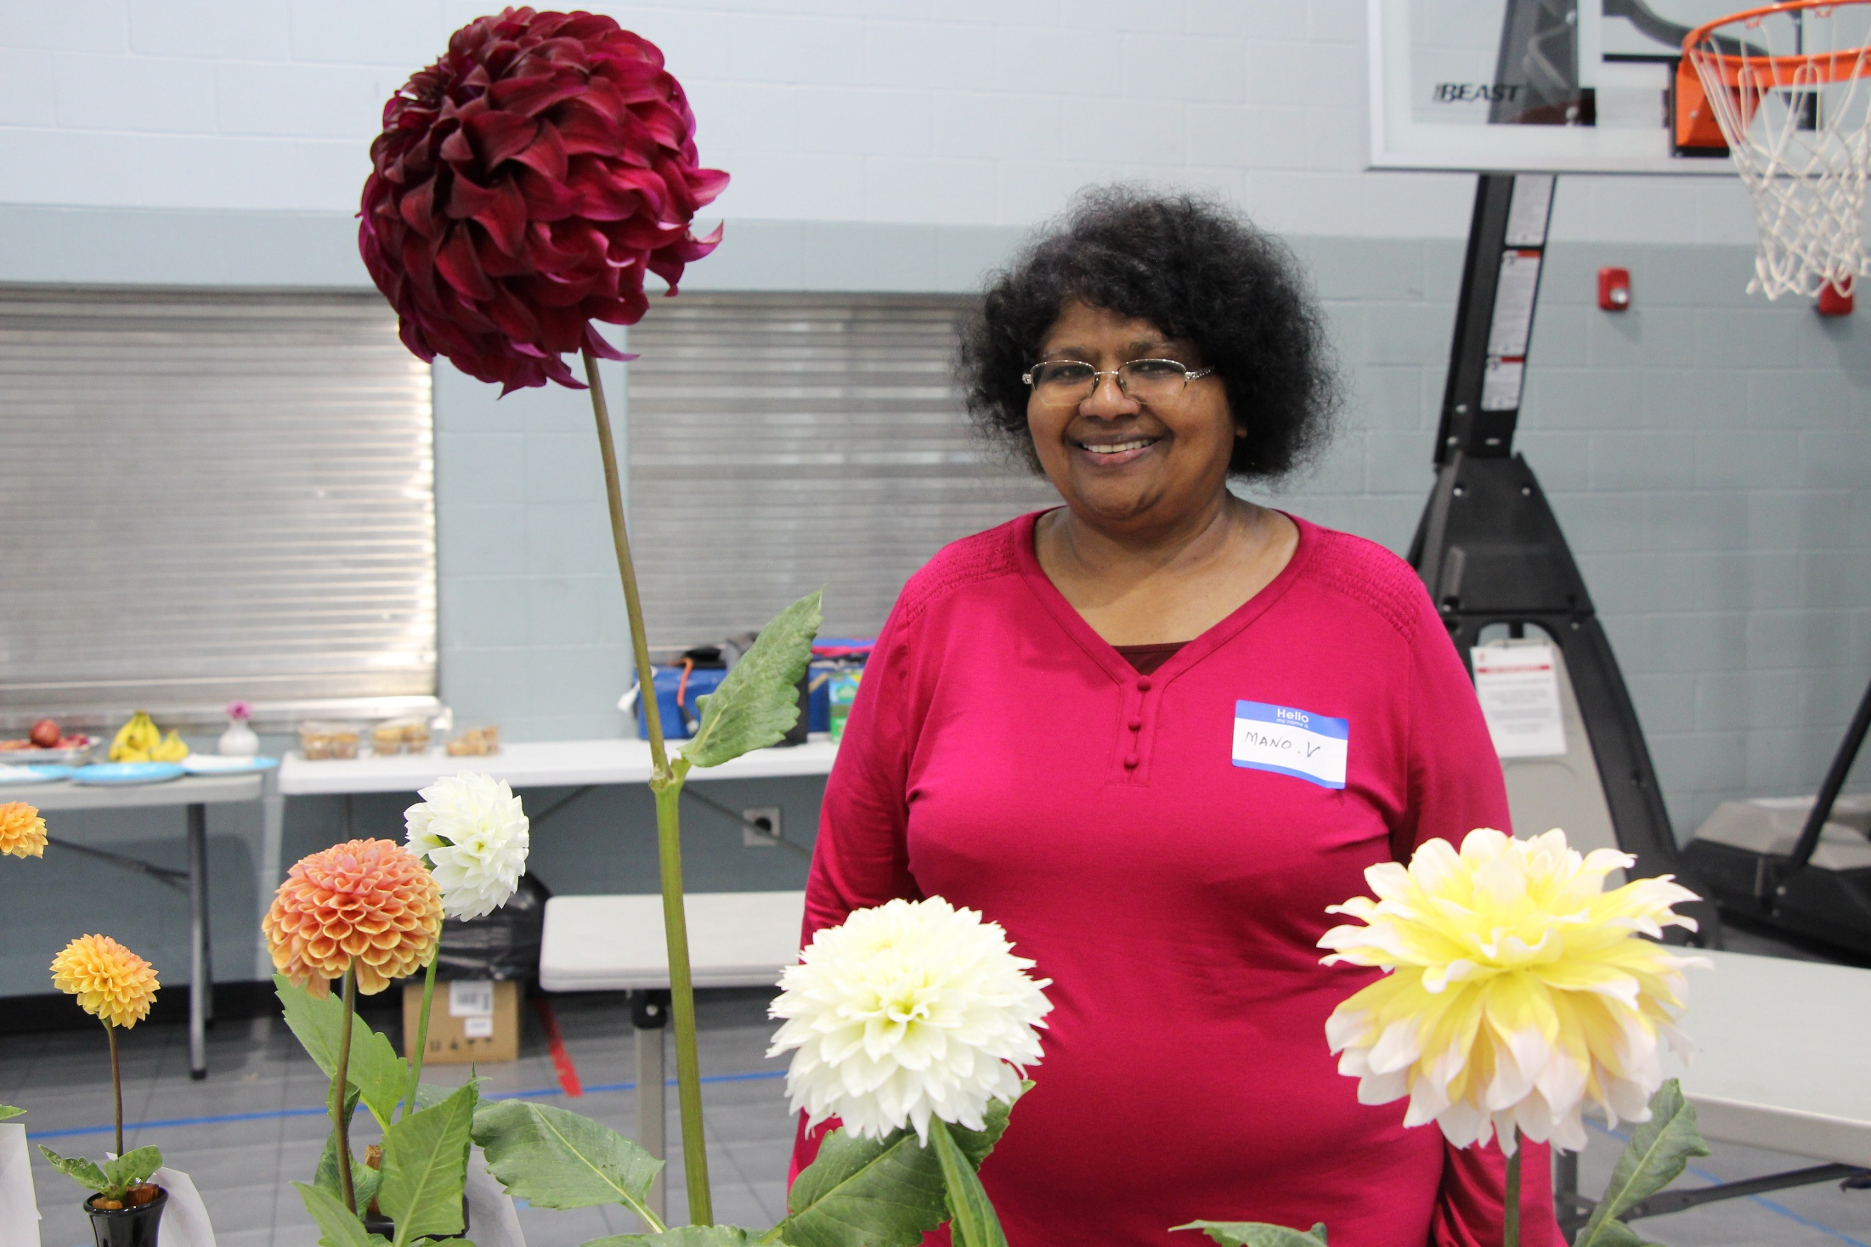

Slide 53
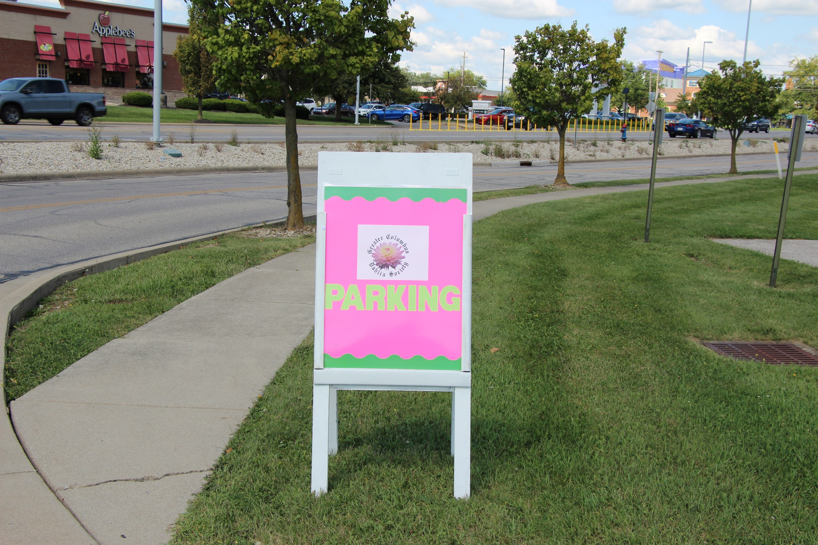

Slide 54
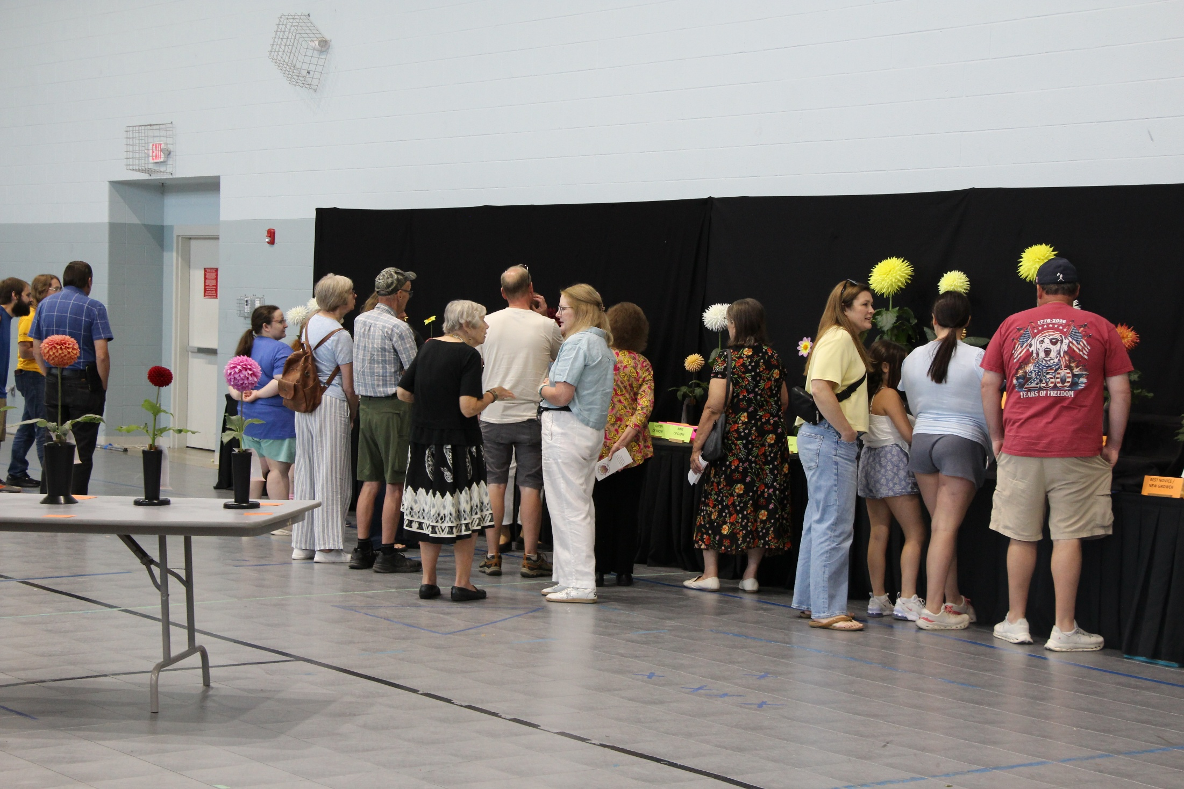

Slide 55
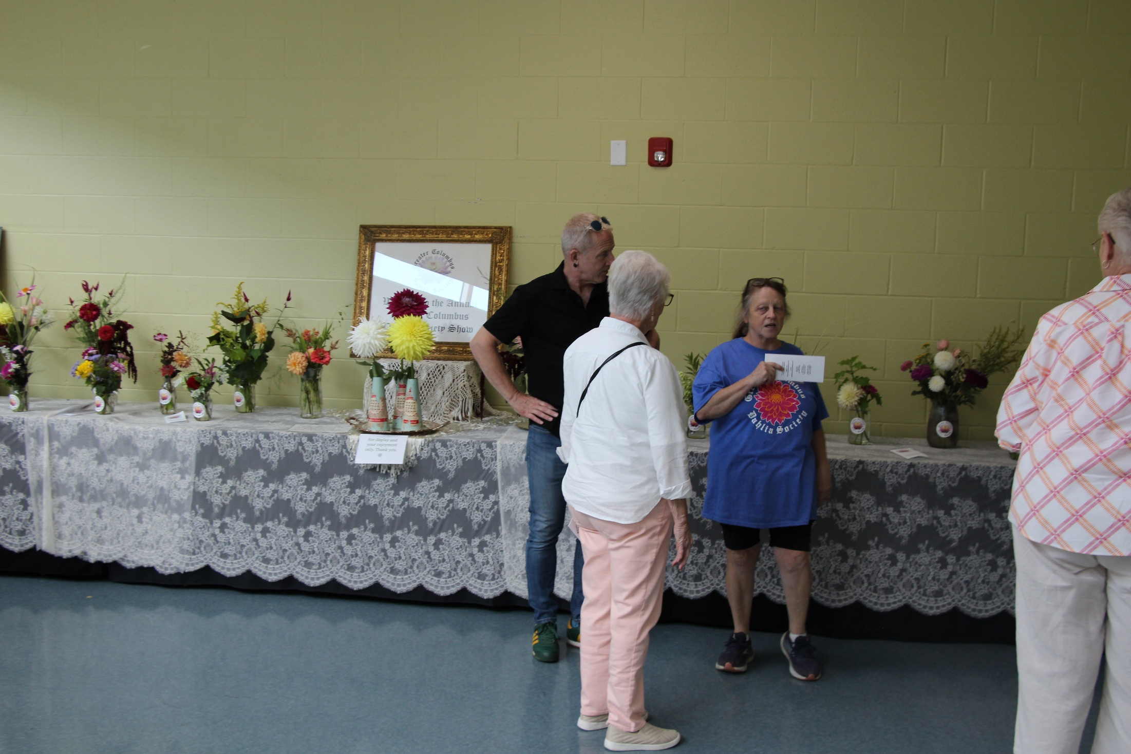

Slide 56
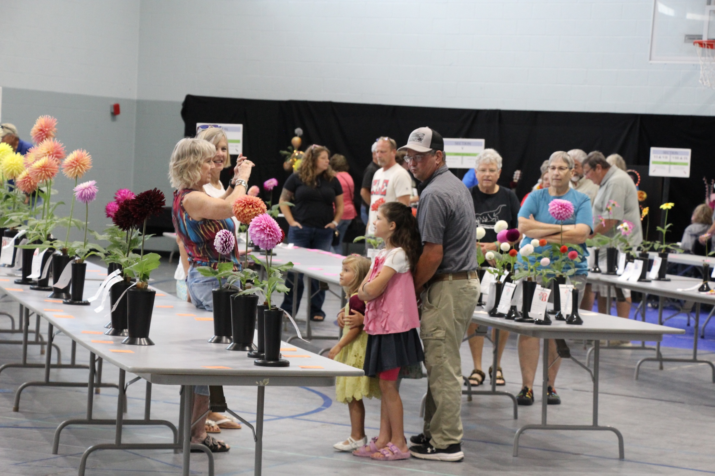

Slide 57
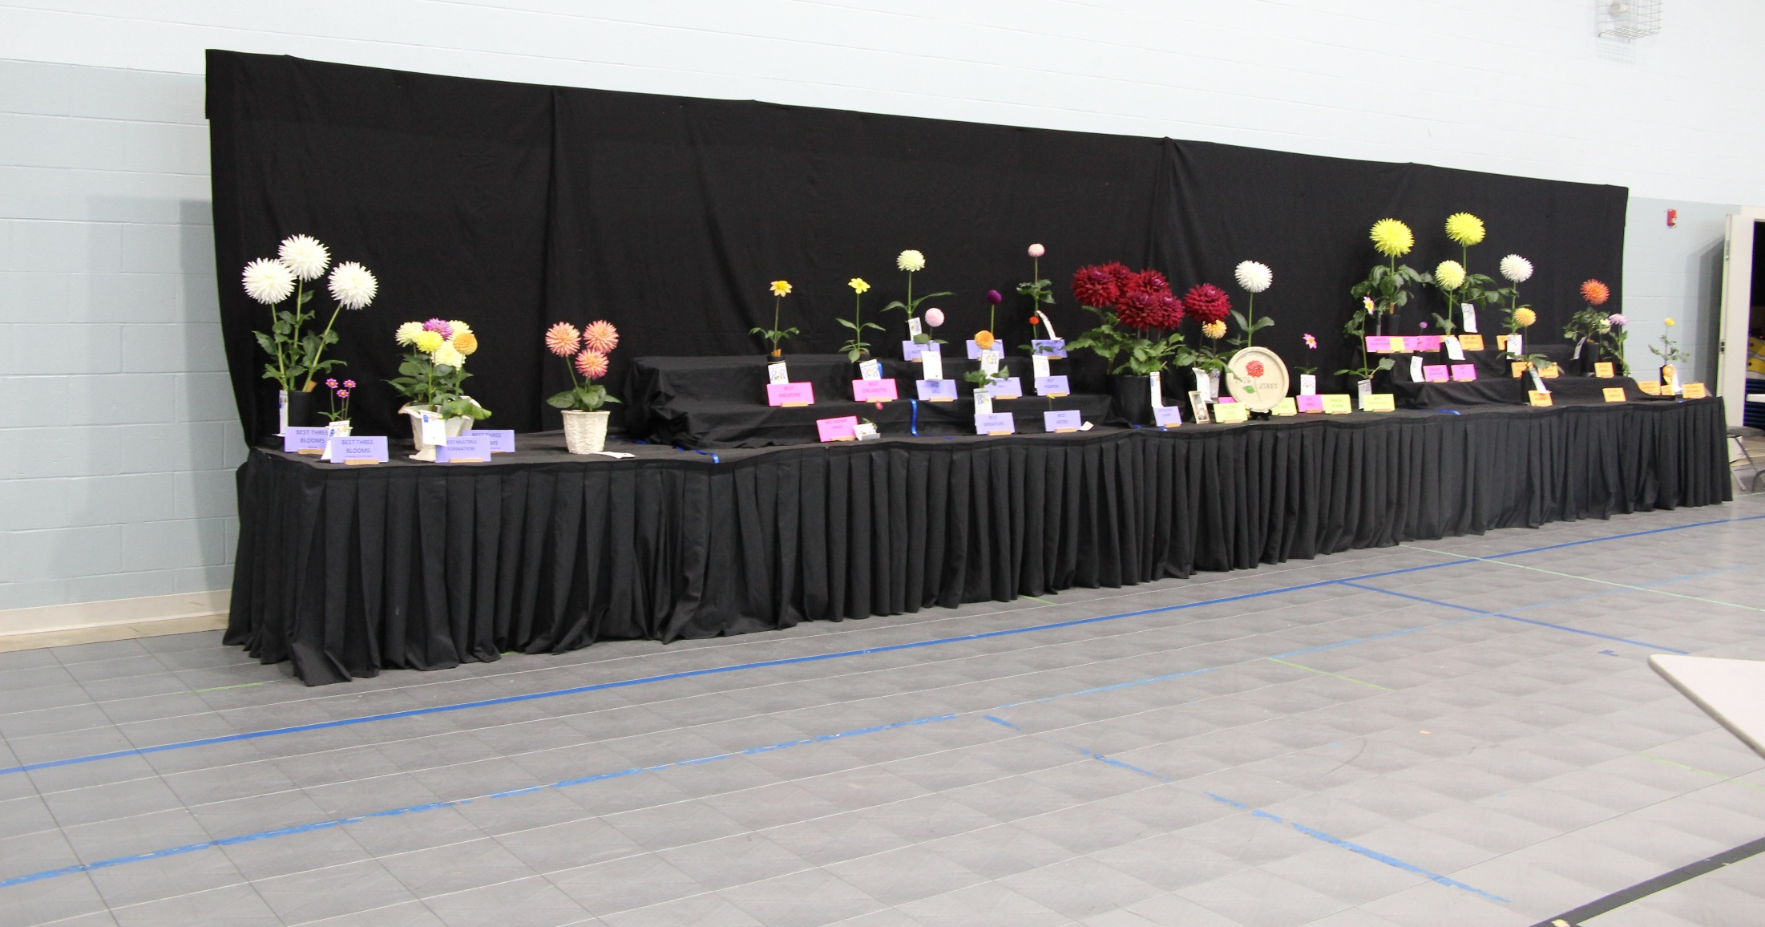
The Honor Court

Slide 58
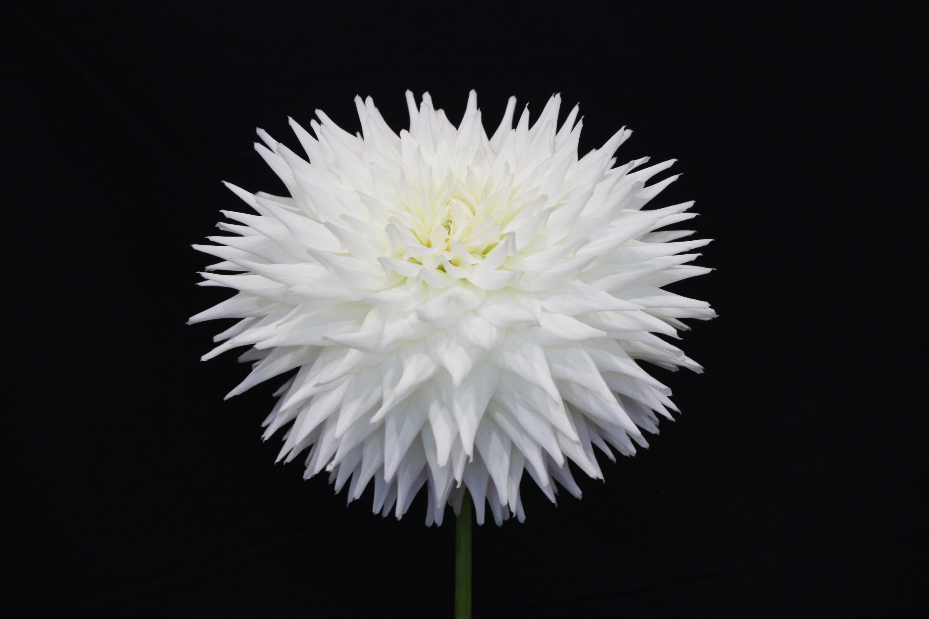
King of Show
Best A
Best Large Grower A
Clearview Edie
Dick Westfall

Slide 59
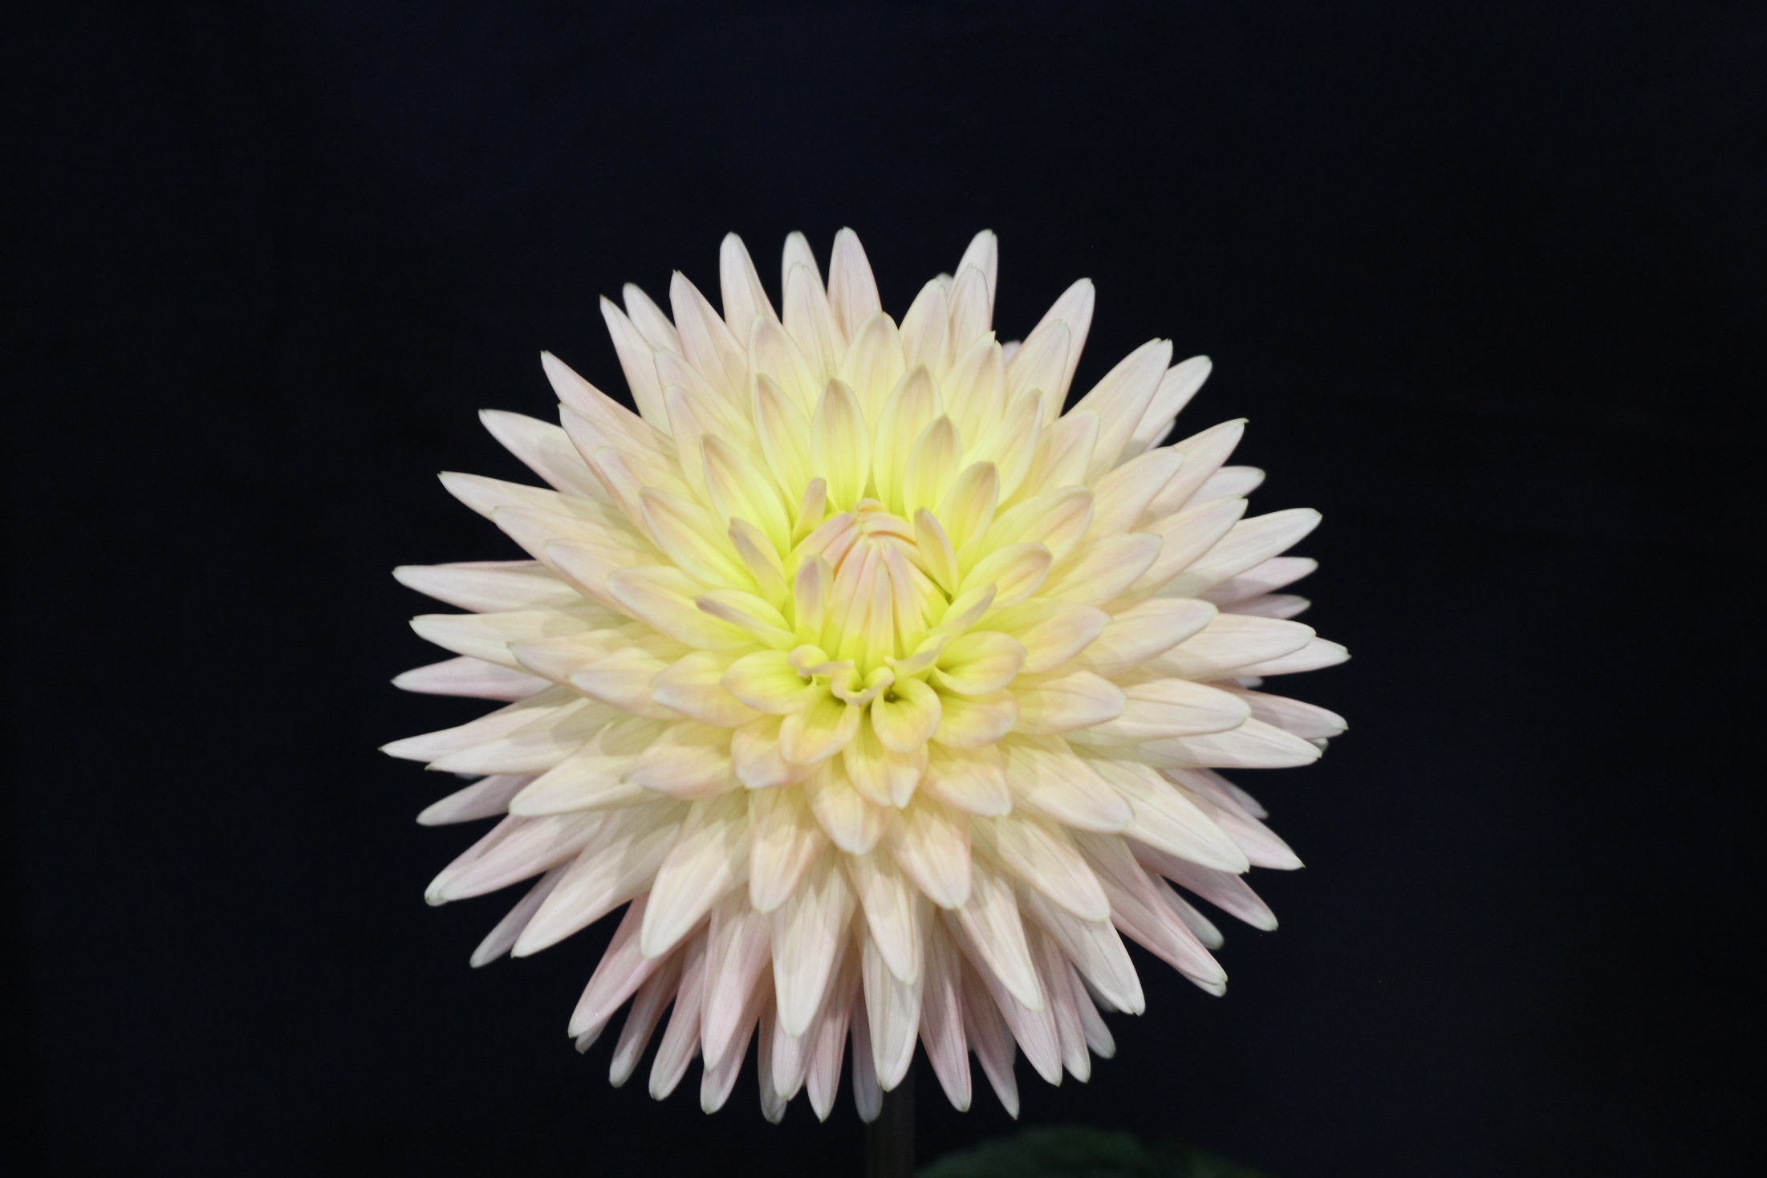
Queen of Show
Best BB
Best Small Grower BB
Embrace
Todd Imhoff

Slide 60

Princess of Show
Best Single
Best Carl
Carl
Chris Bryant

Slide 61

Best AA
Best Small Grower AA
Largest Bloom of Show
Wyn’s Neon Dream
Todd Imhoff

Slide 62

Best B
Best Large Grower B
Hamari Accord
Jason Fairchild

Slide 63

Best Novice Bloom
Best Novice Other Types
Ferncliff Spice
Maria Wells

Slide 64

Best Novice AA/A
Dick Westfall
Aaron Sullivan

Slide 65

Best Novice B/BB
Mikayla Miranda
Aaron Sullivan

Slide 66

Smallest Bloom of Show
Frank Holmes
Jeanette Enyart

Slide 67

Best Small Grower B
Woodland’s Wildthing
Todd Imhoff

Slide 68

Best Large Grower BB
Embrace
Jim Chuey and
Harriet Chandler

Slide 69

Best Miniature
Caleb’s Orange Crush
Jim Chuey and Harriet Chandler

Slide 70

Best Micro
Cobequid Celestial Star
Tammy May

Slide 71

Best Ball
20th Avenue Memory
Tammy May

Slide 72

Best Miniature Ball
Windhaven Concord
Tammy May

Slide 73
Best Pompon
Poppet
Jason Fairchild

Slide 74
Best Waterlilly
Cameo
Jim Chuey and
Harriet Chandler

Slide 75
Best Novelty Double Center
Valley Porcupine
Tammy May

Slide 76
Best Anemone
Bloomquist Golden
Jeanette Enyart

Slide 77
Best Collarette
Baron Aunt Dorothy
Dick Westfall

Slide 78
Best Mingon Single
Stillwater Plum
Tammy May

Slide 79
Best 3 Blooms
AA/A
Clearview Edie
Todd Imhoff

Slide 80
Best 3 Blooms
B/BB
Jackie’s Parfait
Chris Bryant

Slide 81
Best 3 Blooms
Open Center
Kelsey Dwarf
Tammy May

Slide 82
Best 3 Blooms
Other Fully Double Forms
Cameo
Jim Chuey and
Harriet Chandler

Slide 83
Best Multiple Forms
Jim Chuey and
Harriet Chandler

Slide 84
Best Multiple Blooms
Zorro
Chris Bryant

Slide 85
Best
Marcella Louise
Marcella Louise
Jim Chuey and
Harriet Chandler

Slide 86
Arrangements
Class AR4 –America’s 250th Birthday
1st Place Peg Van Scyoc
2nd Place Brian Moody

Slide 87
Class AR3 -- Commemorating 9/11
1st Place Peg Van Scyoc
2nd Place Jan Moody

Slide 88
Class AR2 – Rock ‘n’ Roll
Best Arrangement
1st Place Peg Van Scyoc
2nd Place Brian Moody

Slide 89

Class AR1 – The Moon Landing
1st Place Brian Moody
2nd Place Peg Van Scyoc

Slide 90


Photographs
Class A – Single Dahlia
1st Place Michele Crane
2nd Place Michele Crane

Slide 91


Class B -- Macro
1st Place Barry Crane
2nd Place Peg Van Scyoc

Slide 92


Class C – Multiple Dahlias
2nd Place Jeff Laine
1st Place Michele Crane

Slide 93


Class D – Dahlia(s) with Critters
Best Photograph
1st Place Brian Moody
2nd Place Linda Laine

Slide 94


Slide 95


Slide 96

Photography by
Linda & Jeff Laine

