Slide 1
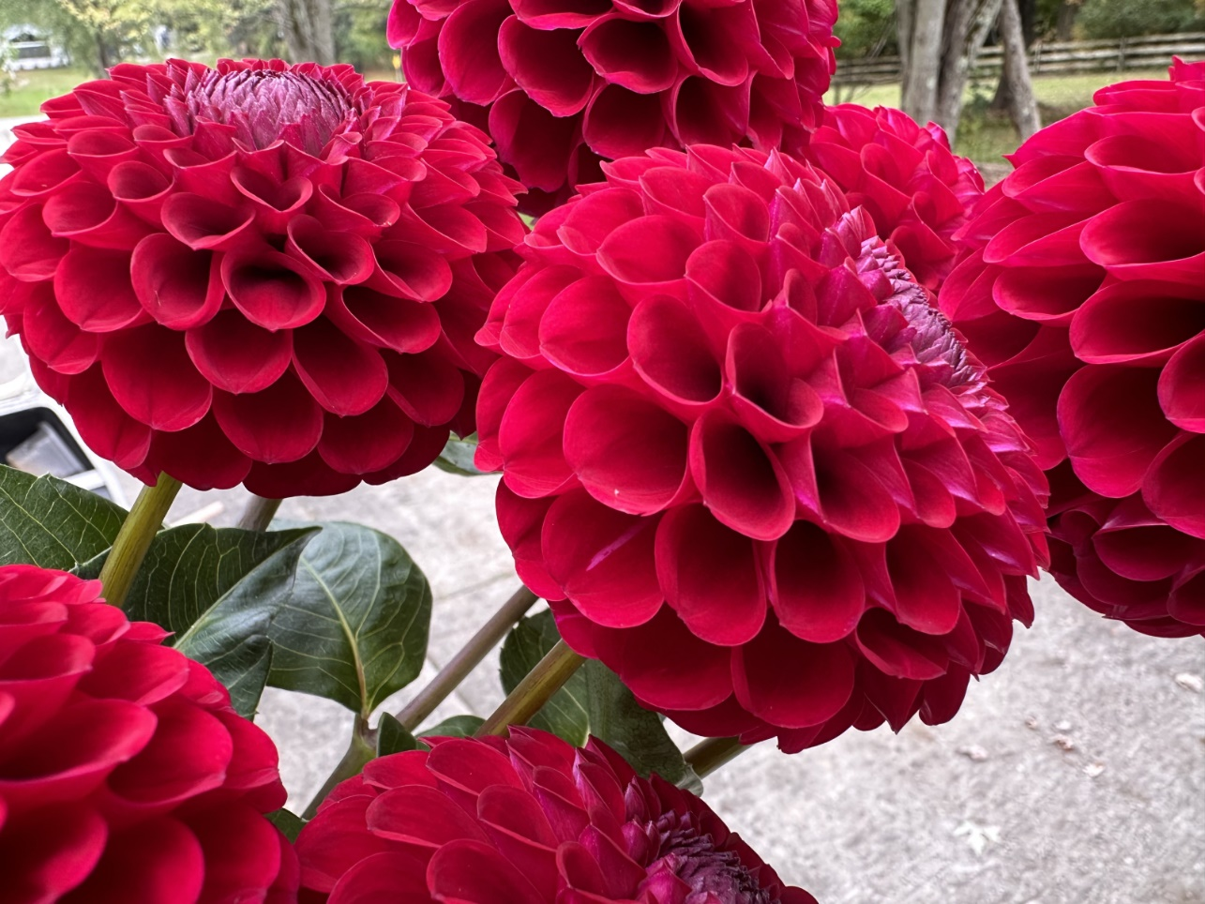
ADS 2023 photo contest has announced its awards and three of our members are winners
3rd Place, Multiple Blooms
Hello Jackie by Chris Bryant

Slide 2
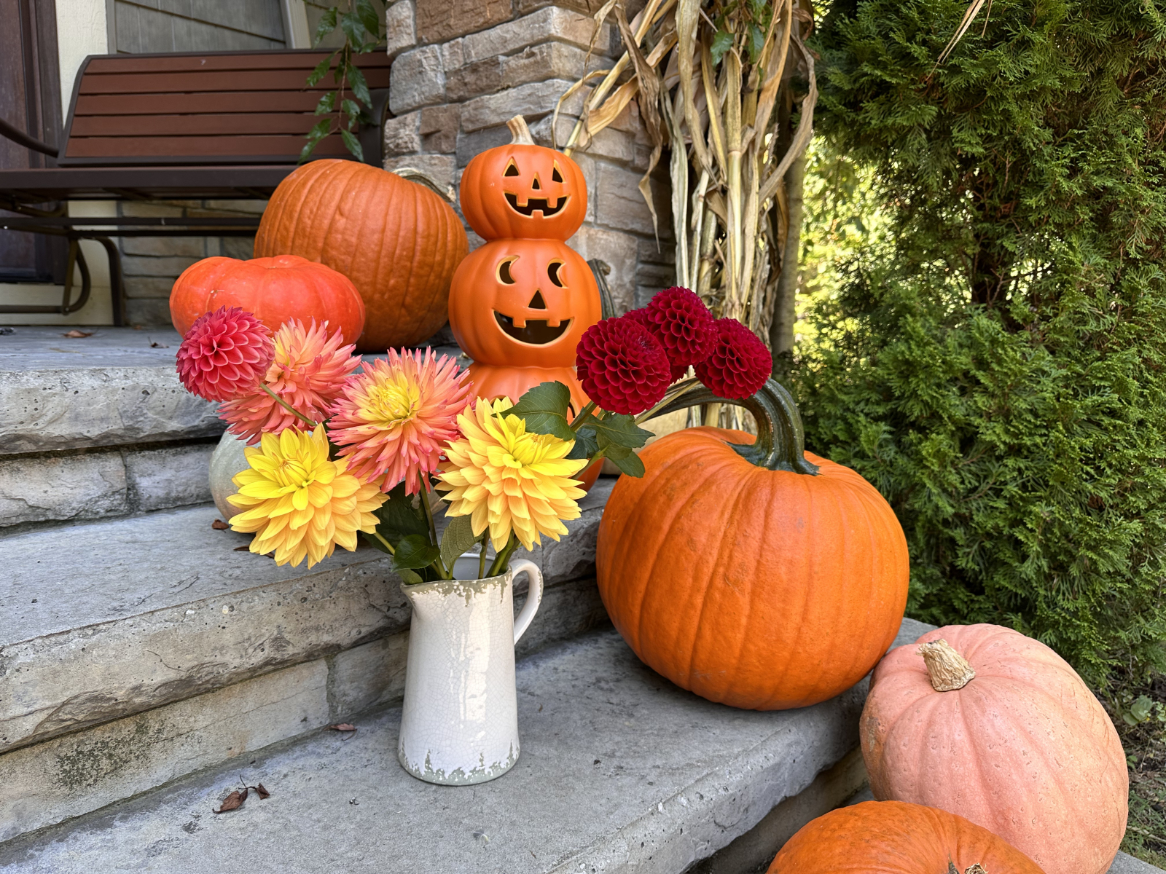
3rd Place, Dahlia Arrangements/Bouquets
Trick or Treat by Quinn Bryant

Slide 3
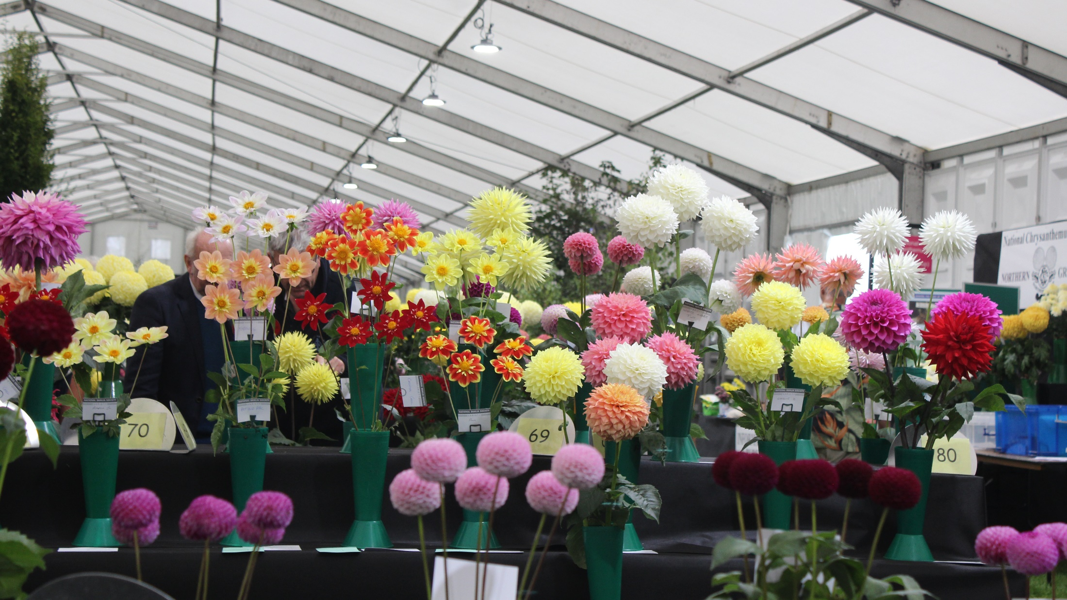
1st Place, Dahlia Clubs and Shows
Harrogate, UK by Jeff Laine

